Slide 1
INSURANCE, TAXES, CHECKBOOKS & PAYCHECKS
Real World Economics
By Tim Obergfell

Slide 2
Paychecks

Slide 3
Paychecks
Salary- fixed payment by employer- biweekly, weekly or monthly
Hourly- Paid per hour you are on the job
Cash- Under the table payments- mow grass don’t have to claim taxes

Slide 4
Paychecks
Gross- What you make prior to taxes
Net- What money you receive after taxes
Taxes- Government gets paid 1st
Insurance- Take out medical, insurances, and more.
Depending on taxes you might only see 60% of your salary!!!

Slide 5
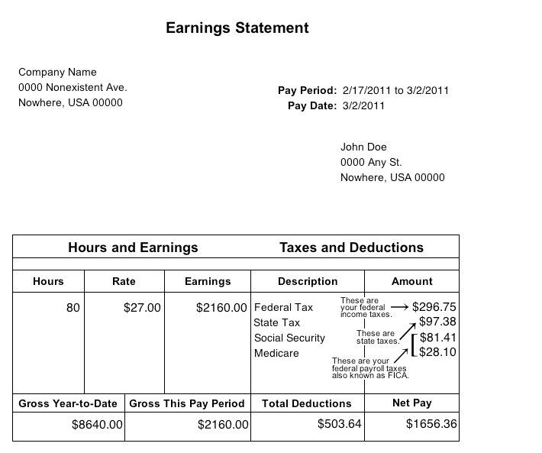

Slide 6
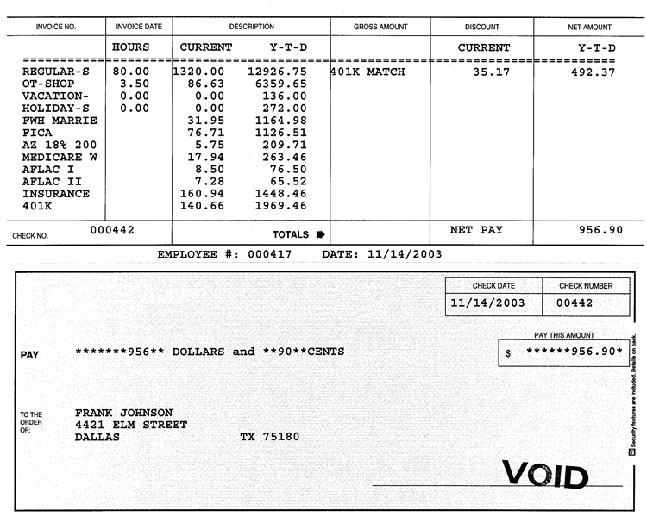
SAMPLE PAYCHECKS

Slide 7
Decoding your paycheck
http://www.themint.org/kids/decoding-your-paycheck.html

Slide 8
Taxes you will pay

Slide 9
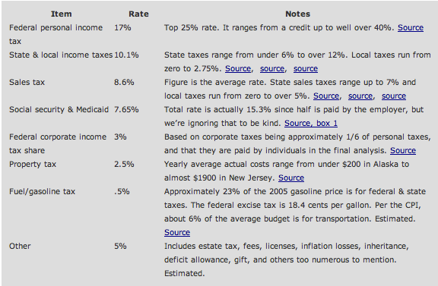
Taxes

Slide 10
INCOME TAXES
Federal income tax- A tax on personal income you make.
State income tax- additional tax on income by state
Progressive Tax- More you make the more you pay
16th Amendment- allowed govt. to tax income- originally targeted the richest Americans. Less than 1% paid in 1913
Govt. makes 3.3 trillion a year off taxes

Slide 11
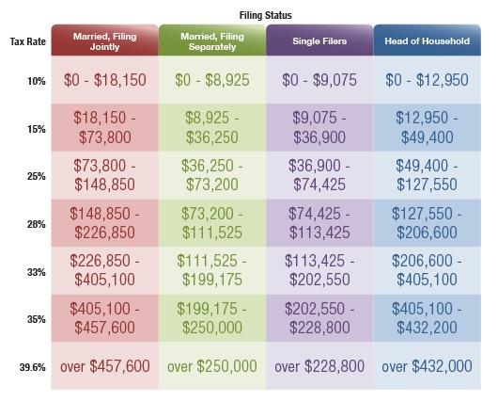
Federal Tax Bracket

Slide 12
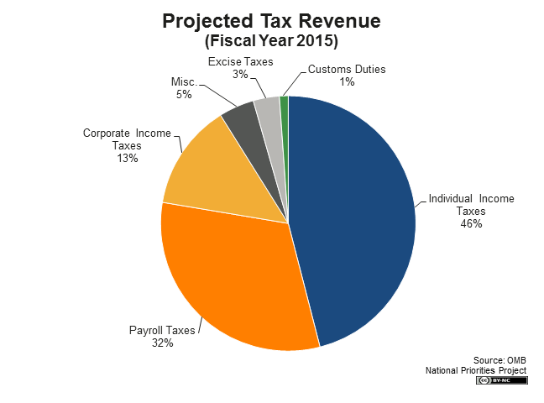

Slide 13
Payroll deductions
Federal income tax- based off how much you make
FICA- Federal Insurance Contributions ACT- All pay
FICA Taxes- Social Security 6.2% (Employer pays 6.2%)
Medicare 1.45% (Employer pays 1.45%)
Individuals pay 7.45% in FICA tax

Slide 14
Payroll Deductions
State Income Tax- based on income 5%
Local Income Tax- 1% in Sandusky- no Perkins

Slide 15
If your income range is between $0 and $5,000, your tax rate on every dollar of income earned is 0.587%.
If your income range is between $5,001 and $10,000, your tax rate on every dollar of income earned is 1.174%.
If your income range is between $10,001 and $15,000, your tax rate on every dollar of income earned is 2.348%.
If your income range is between $15,001 and $20,000, your tax rate on every dollar of income earned is 2.935%.
If your income range is between $20,001 and $40,000, your tax rate on every dollar of income earned is 3.521%.
If your income range is between $40,001 and $80,000, your tax rate on every dollar of income earned is 4.109%.
If your income range is between $80,001 and $100,000, your tax rate on every dollar of income earned is 4.695%.
If your income range is between $100,001 and $200,000, your tax rate on every dollar of income earned is 5.451%.
If your income range is $200,001 and over, your tax rate on every dollar of income earned is 5.925%.

Slide 16
Use map on following slide- NY or TX?
Carmelo Anthony was offered 88 million by Houston (Texas) for four years = 22 million
Offered 130 million by New York for five years = 26 million
How does the state income tax affect his actual net pay??? Where should he go?

Slide 17
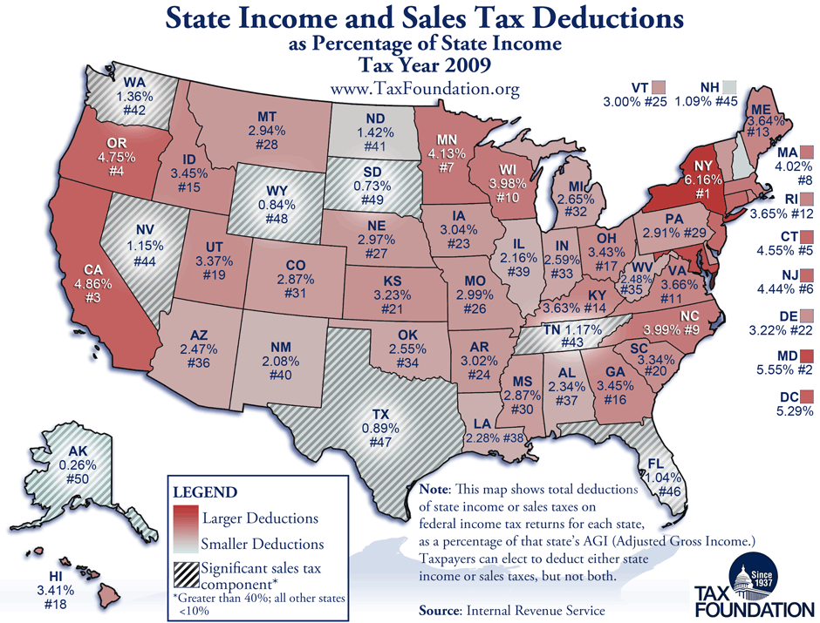

Slide 18
Carmelo
Texas Offer- 22 million @ .89%= 195,800 in taxes per year to state
NY offer- 26 million @ 6.16% = 1,600,601 in taxes to NY
Carmelo really only makes 24,400,000 living in NY
Realize he already pays 10,296,000 per year in federal taxes no matter what

Slide 19
State Income tax
Think of where you live in the future and how income tax could effect your take home pay.

Slide 20
HOW TAXES EFFECT YOU?
Income- You make less so you spend less
Slows spending
Government makes more- can provide more to citizens
Increase government

Slide 21
FILING TAXES
Middle of April: every year if you worked you must file income taxes
Single, Married (joint or individual), Widow
Tax returns can give you money back that the government over taxed you on or you may owe additional money if you have not paid enough in taxes.

Slide 22
EXEMPTIONS
Exemption- Item the government views as exempt from taxation to encourage citizens to invest or do these
401 (k)- Govt. wants you to invest in retirement
529 College Adv- Govt. wants you to invest in college
Personal- Goodwill donations, cars, charity, student loans, home interest
Business write-off- Sports team tickets, donations

Slide 23
CREDITS
Credits- Government gives money back to citizens for certain deductions
1,000 per child
Daycare services
College- 2,500
Energy efficient appliances

Slide 24
Sales Tax
Sales tax- Tax on items people buy
7.25% for Erie County 2014- Commissioners voted on hike for roads
Ohio state sales tax 5.75%

Slide 25
Property
Property Tax- tax on ownership of property
Varies depending on the type of land
Varies on size of house & location
See how much you property tax is

Slide 26
Your Property Tax
http://erie.iviewauditor.com/
Quick search upper rt. corner
Click on parcel #
Click on tax
Look to the total # - paid in 1/2 years

Slide 27
Other taxes
Cigarette Tax
Corporate Income Tax (passed on to the consumer)
Dog License Tax
Federal Unemployment Tax (FUTA)
Fishing License Tax
Food License Tax
Gasoline Tax
Hunting License Tax
Inheritance Tax Interest expense (tax on the money)
Inventory tax IRS Interest Charges (tax on top of tax)
Well Permit Tax

Slide 28
Other taxes
Liquor Tax
Local Income Tax
Marriage License Tax
Property Tax
Retail Sales Taxes
Recreational Vehicle Tax
Road Toll Booth Taxes
State Income Tax
Telephone federal excise tax, universal service fee, local and state surcharges, minimum usage surcharge, usage charge tax.
Toll Roads, Bridges, and Tunnels
Traffic Fines (indirect taxation)
Utility Taxes
Vehicle License Registration
Vehicle Sales Tax

Slide 29
Can you see why some people don’t like taxes???

Slide 30
Insurance
Insurance protects you (or) valuables from loss or damage

Slide 31
Insurance Types
Health / Medical
Life
Auto (700 per car per year)
Personal items- valuables, gold
Home - flood, fire, tornado
Disability / Long Term Care /Cancer
Retirement- Income insurance?

Slide 32
Insurance Terms
Premium: premium is the monthly fee that is paid to an insurance company or health plan to provide health coverage, including paying for health-related services such as doctor visits, hospitalizations, and medications.
Deductible: A deductible is the amount you must pay out-of-pocket each year for health-related expenses before your insurance policy begins to pay.
Coinsurance: Some health insurance requires that you pay a percentage of the cost of covered health-related services after you have met your annual deductible. This is known as coinsurance and most often is about 20% of what your health plan approves.
Copayment: A copayment is a flat fee, or set amount that you may have to pay for a specific health-related service.

Slide 33
For example: Mr. Jones has a family health plan with a $500 annual deductible and 20% coinsurance.
In February, his wife and two children got checkups. Mr. Jones paid the physician for these services, which cost $510.
In March, one of the children got sick and the cost of the office visit was $50. Since the annual deductible was met, the health plan paid the doctor $40 (80%) and Mr. Jones paid the doctor $10 (20%).

Slide 34
Health Insurance Stats
The average annual premiums in 2014 are $16,000 per family. Up 4% from last year. Average worker paying 4,565 out of pocket (NCSL 2014). Wages have gone up 1.8%. Since 2003, premiums have gone up 80% and is rising 3x’s the amount of wages (NCSL 2014).
Average single and family premiums for covered workers are higher in the Northeast and lower in the South than the average premiums for covered workers in other regions (Exhibit 1.3).
Smaller firms (3-199 workers) have a lower average family premium ($13,250) than larger firms (200 or more workers) ($16,338).
Average monthly payment $440 per month

Slide 35
Historical Stats
2000- $6,000 today Average cost - $16,000- almost tripled costs in 14 years
So... this means people have less income?

Slide 36
Health / Medical Insurance
Insures you for medical costs
#1 Reason for bankruptcy in US
Premium- 100-500 per month
Co-Pays- Per visit to Dr. $20-150
Deductible- Amount you pay till insurance kicks in. No claims- no pay
Co-Insurance- 80/20 on any procedure - max amount

Slide 37
Insurance cont...
Health insurance provided by an employer. Most large and midsize companies in the U.S. provide health insurance as an employee benefit. The majority of Americans who have health insurance get it from the company they work for.
Health insurance that you purchase on your own. If you are self-employed or work for a small company that does not provide health insurance, you will need to buy insurance.
Health insurance provided by the government. If you are 65 or older, disabled, or have little or no income, you may qualify for health insurance paid for by the government, such as Medicare and Medicaid.
No Insurance- 45 million in US

Slide 38
No Insurance
Who pays if someone can’t/doesn’t???
Cannot refuse to service someone- so they go to the ER and get a 10,000 bill?
Hospital- just raise premiums for everyone else to get their money

Slide 39
Stats on Health Insurance
149 million company covered
85 million on Govt. Health care
26.5 million pay for own insurance
45 million no insurance

Slide 40
Government Health Care
Created 1965 by LBJ- “Great Society”
85 million on Govt. Health Care
Medicare-44 million people
Medicaid- 41 million
Costs 21% of Govt. spending, 5.4% of GDP for these two programs

Slide 41
Medicare
Government health care for 5 or more year citizens ages 65 & over or disabled
Different forms of Medicare A-D. You have to pay for some additional coverage if you want.

Slide 42
Who pays???
Medicare part of FICA- Federal Insurance Contributions act.
2.9% of wages (You pay 1.45, employer pays 1.45) Self employed pay both
2013- Additional .9% Medicare for those who make over $200,000

Slide 43
Medicaid
Government Health care for those that cannot afford insurance.
States have to follow certain federal rules and federal government reimburses costs to states
States and federal government fund

Slide 44
Medicaid Eligible
Medicaid is an “entitlement” program, which means that anyone who meets eligibility rules has a right to enroll in Medicaid coverage.
children under age 6 in families with income below 133 percent of the federal poverty line ($25,975 for a family of three in 2013);
children aged 6-18 in families with income below the poverty line;
pregnant women with income below 133 percent of the poverty line;
parents whose income is within the state’s eligibility limit for cash assistance that was in place prior to welfare reform; and
most seniors and persons with disabilities who receive cash assistance through the Supplemental Security Income (SSI) program.

Slide 45
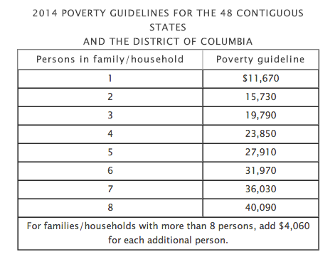

Slide 46
Obamacare
https://www.youtube.com/watch?v=o84Xz3_BQjc#t=18
Website: https://www.healthcare.gov/

Slide 47
Affordable Care Act
“Obamacare”
You pay fine if you don’t have insurance
Businesses have to insure employees or be fined
Age 26 on parents insurance
Can’t deny on pre-existing conditions
Good / Bad? Costs richest Americans .9% more

Slide 48
Life Insurance
Life Insurance-Insurance money paid to family If you die- (Really death insurance?)- I pay(350 a year) 250,000
Whole Life- Insures you for death your entire life is more expensive but you will get $ at some point
Term Life- Insurance for 10,20,30 years- cheaper but money is lost

Slide 49
Auto
Auto insurance- Pays for wrecks- theft- damage- not wear and tear tires, wipers
Premium- Changes based on your driving record. More points pay more
Age, Record all play factor in premium
Deductible- Lower or Higher will change your premium. Take a high deductible if you are safe???
$850 per year for my family(2 cars)

Slide 50
Home Insurance
Covers home and contents in the home
Fire, flood, tornado, destruction, hail
Less than car? Why?
Flood and disasters- if you live in a flood plain costs more
$700 per year for me

Slide 51
Personal item insurance
Can insure wedding rings
Boats
Motorcycle
Collectibles- Baseball cards, stamps etc…

Slide 52
Long Term Care policies
Long term care Policies- nursing homes
Cancer Policies-
Disability Policies- not working and no income you would go bankrupt?

Slide 53
RENTERS INSURANCE
Renter’s insurance- would cover your valuables in case of loss, depends on how expensive your stuff is to get covered.
You will live in - College or Apartments
The building will be covered but not your belongings
Any loss due to flood, fire, tornado etc… might not be covered by the owner

Slide 54
INCOME INSURANCE
Retirement
Social Security, 401(K), STRS, Disability

