Slide 1
Spinrad/Psychology
Antipsychotic Drugs

Slide 2
Fix it with a pill?

Slide 3
Older generation drugs
Chlorpromazine (Thorazine)
First synthesized on December 11, 1950
the single greatest advance in psychiatric care, dramatically improving the prognosis of patients in psychiatric hospitals worldwide
one of the driving forces behind the deinstitutionalization movement
largely superseded by the newer atypical antipsychotics, which are usually better tolerated, and its use is now restricted to fewer indications
Side effects include sedation, slurred speech, dry mouth, constipation, urinary retention and possible lowering of seizure threshold. Appetite may be increased with resultant weight gain and dizziness. Memory loss and amnesia have also been reported.

Slide 4
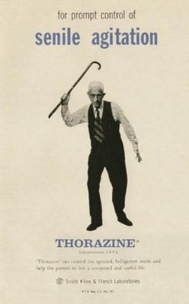
Thorazine ad

Slide 5
Older generation drugs
Haloperidol (Haldol)
In US since 1967
Side effects: The risk of the face-disfiguring tardive dyskinesia (twitching) is around 4% per year in younger patients. Other predisposing factors may be female gender, pre-existing affective disorder, and cerebral dysfunction. Akathisia (restlessness) often manifests itself with anxiety, dysphoria, and an inability to remain motionless.

Slide 6
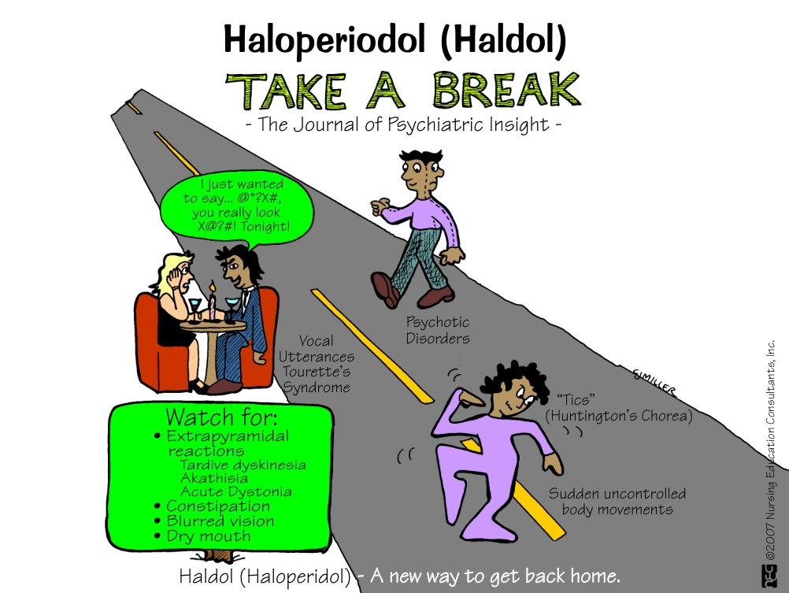
Haldol

Slide 7
Newer “second generation” drugs
Clozapine (1989)
usually used as a last resort in patients that have not responded to other anti-psychotic treatments due to its danger of causing agranulocytosis (lowered white blood cell count) as well as the costs of having to have blood tests continually during treatment. It is, however, one of the very effective anti-psychotic treatment choices
Risperidone (Risperdal)
the only drug agent available for treatment of schizophrenia in youths, ages 13–17

Slide 8
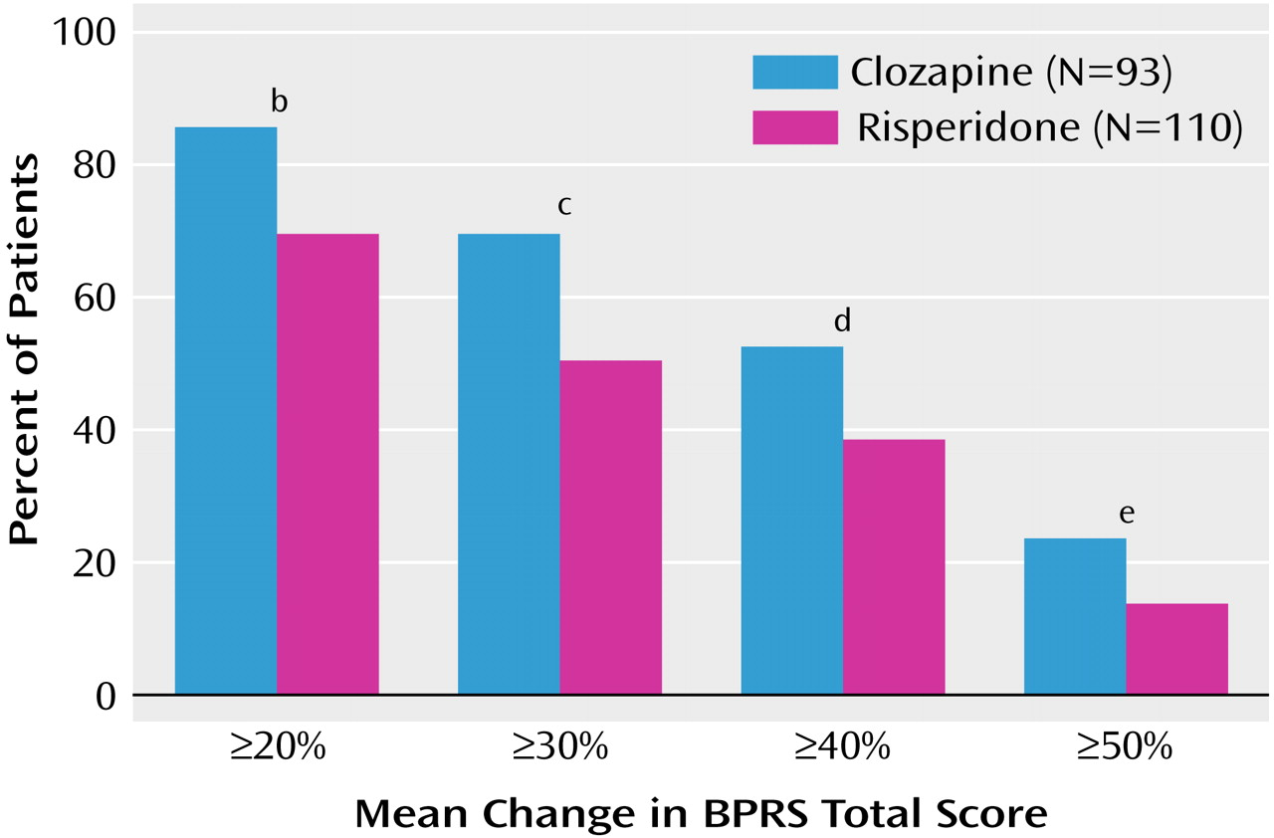
Second generation

Slide 9
How do they work?
Block or reduce the sensitivity of brain receptors that respond to dopamine
Some also increase the level of serotonin, a neurotransmitter that inhibits dopamine activity

Slide 10
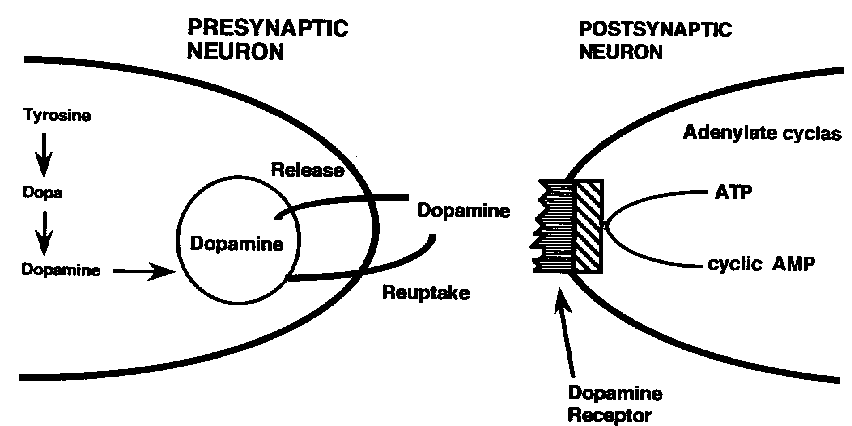
How do they work?

Slide 11
Managed care
Managed care organizations prefer to pay for one visit to a psychiatrist and a prescription rather than multiple visits for psychotherapy
Drug company advertising also makes the medical approach more popular
Most countries do not allow these types of ads for the public

Slide 12
Advertising

Slide 13
Criticisms
Biochemical abnormalities can be changed by new experiences or psychotherapy
Effectiveness depends on the individual, the problem, and whether medication is combined with therapy

