Slide 1
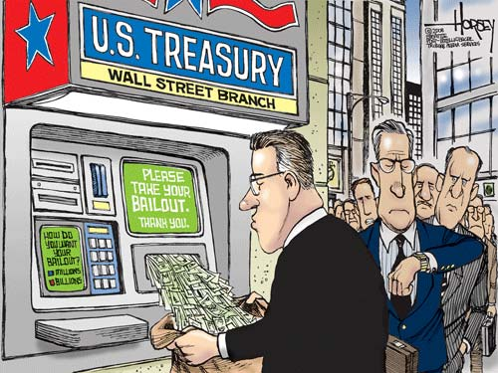
MARKET STRUCTURES
ECONOMICS CHAPTER 7

Slide 2
BELLWORK
IS IT EVER “OK” FOR THE GOVERNMENT TO REGULATE PRICES?
Why/Why Not?

Slide 3
FOCUS QUESTION
WHAT ARE THE FOUR TYPES OF MARKET STRUCTURES & WHAT ROLE DOES THE GOVERNMENT PLAY?

Slide 4
MARKET STRUCTURES
 | PERFECT COMPETITION | MONOPOLISTIC COMPETITION | OLIGOPOLY | MONOPOLY
How many suppliers are there?
What influence do firms have over price?
How much competition exists?
Are all firms selling identical products?
Is it easy or difficult to enter the market?

Slide 5
WHAT IS “GOOD COMPETITION”?
PERFECT COMPETITION: A market structure that requires a set of ideal conditions:
Large # of buyers and sellers
Identical products
Buyers and sellers act independently
Buyers and sellers are well-informed
Buyers and sellers are free to enter into, conduct, or get out of business.

Slide 6
MONOPOLISTIC COMPETITION
MONOPOLISTIC COMPETITION: Market structure that has all the conditions of Perfect Competition except for identical products.
Characterized by PRODUCT DIFFERENTIATION—real or perceived differences
To make products stand out, competitors rely on NONPRICE COMPETITION —the use of advertising, giveaways, or other promotions.

Slide 7
OLIGOPOLY
OLIGOPOLY: Market structure in which a few very large sellers dominate the industry.
Products may have distinct features
Tend to act together with price changes so many firms prefer to compete on a non-price basis.
Can lead to PRICE-FIXING, or agreeing to charge the same amount for a product.

Slide 8
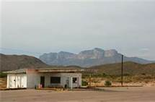
TYPES OF MONOPOLIES
NATURAL MONOPOLY: A situation where the costs of production are minimized by having a single firm produce the product.
Example: ?
GEOGRAPHIC MONOPOLY: A monopoly based on the absence of other sellers in a certain geographic region.

Slide 9
TYPES OF MONOPOLIES
TECHNOLOGICAL MONOPOLY: Monopoly based on ownership or control of a manufacturing method, process, or other scientific advance.
Example: New drug patents
GOVERNMENT MONOPOLY: a monopoly owned and operated by the government.
Example: uranium production

Slide 10
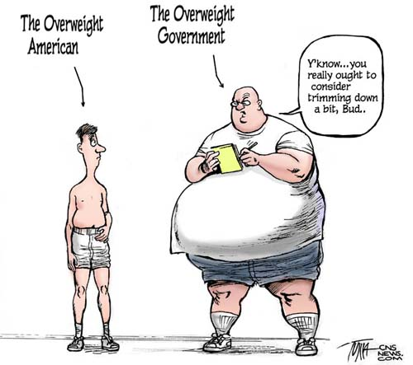
THE GOVERNMENT’S ROLE IN THE ECONOMY

Slide 11
GOVERNMENTS ROLE
1. MAINTAINING COMPETITION
2. PROTECTING CONSUMERS
3. IMPROVING ECONOMIC EFFICIENCY

Slide 12
HOW DOES THE GOVERNMENT MAINTAIN “GOOD COMPETITION”?
The government maintains good competition through legislation and regulation…
SHERMAN ANTITRUST ACT (1890): Outlawed all contracts “in restraint of trade” to halt the growth of trusts and monopolies.
CLAYTON ANTITRUST ACT (1914): Strengthened the Sherman Antitrust Act by outlawing price discrimination.
PRICE DISCRIMINATION: The practice of selling the same product to different consumers at different prices.

Slide 13
FOCUS QUESTION
WHAT ARE THE FOUR TYPES OF MARKET STRUCTURES & WHAT ROLE DOES THE GOVERNMENT PLAY?

Slide 14
RECALL
What are the four types of market structures?

Slide 15
FOCUS QUESTION
WHY DO MARKETS FAIL AND WHAT CAN THE GOVERNMENT DO TO PREVENT THEM FROM FAILING?

Slide 16
WHY DO MARKETS FAIL?
1. Inadequate Competition
Leads to higher prices
No incentive to use resources efficiently
2. Inadequate Information:
Knowing what
consumers want
Keeping consumers
informed about products

Slide 17
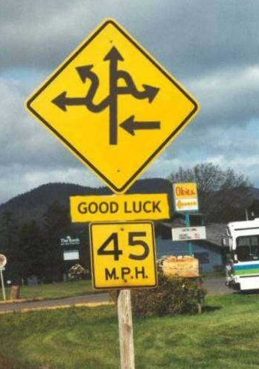
WHY DO MARKETS FAIL?
3. Resource Immobility:
Land, labor, and capital do not move to where returns are the highest.
4. PUBLIC GOODS (need for):
Products collectively used
by everyone.
Markets would not supply
these (no incentive)

Slide 18
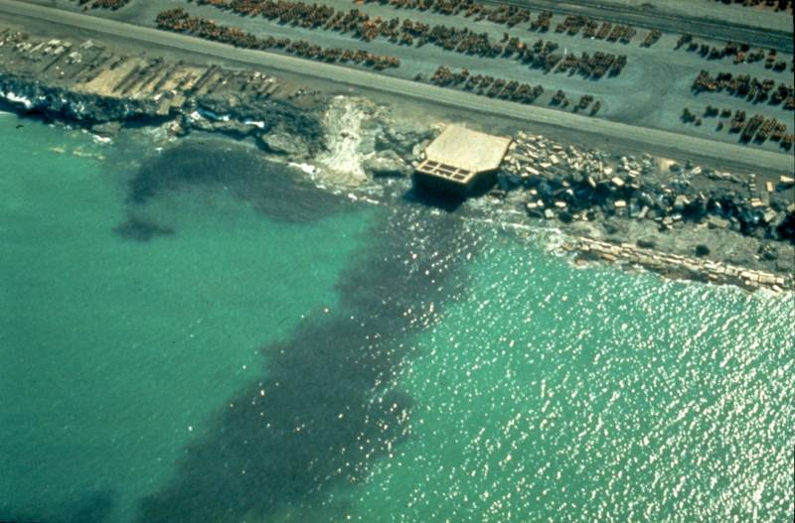
WHY DO MARKETS FAIL?
5. EXTERNALITIES: unintended side effect that neither benefits or harms.
NEGATIVE EXTERNALITY:
harmful unintended side effect
POSITIVE EXTERNALITY:
beneficial unintended side effect

Slide 19
CORRECTING MARKET FAILURES
THINK-PAIR-SHARE: What are ways the government can help prevent the failure of markets?

Slide 20
IMPROVING ECONOMIC EFFICIENCY
The government has the ability to correct two market failures:
Protect Competition
Improving Economic Efficiency

Slide 21
PROTECTING COMPETITION
The government restricts the formation of trusts and monopolies through legislation.
SHERMAN ANTITRUST ACT: Law that makes monopolies and trusts illegal.
In 2001, the Federal Government blocked a merger between U.S. Airways and United citing it would limit competition within the airline industry.

Slide 22
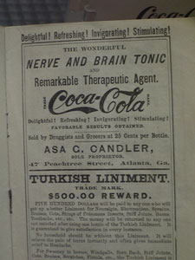
IMPROVING ECONOMIC EFFICIENCY
Correcting Inadequate Information:
PUBLIC DISCLOSURES: the requirement that businesses reveal certain information to the public.
“Truth in Advertising Laws” prevent sellers from making false claims about their product.

Slide 23
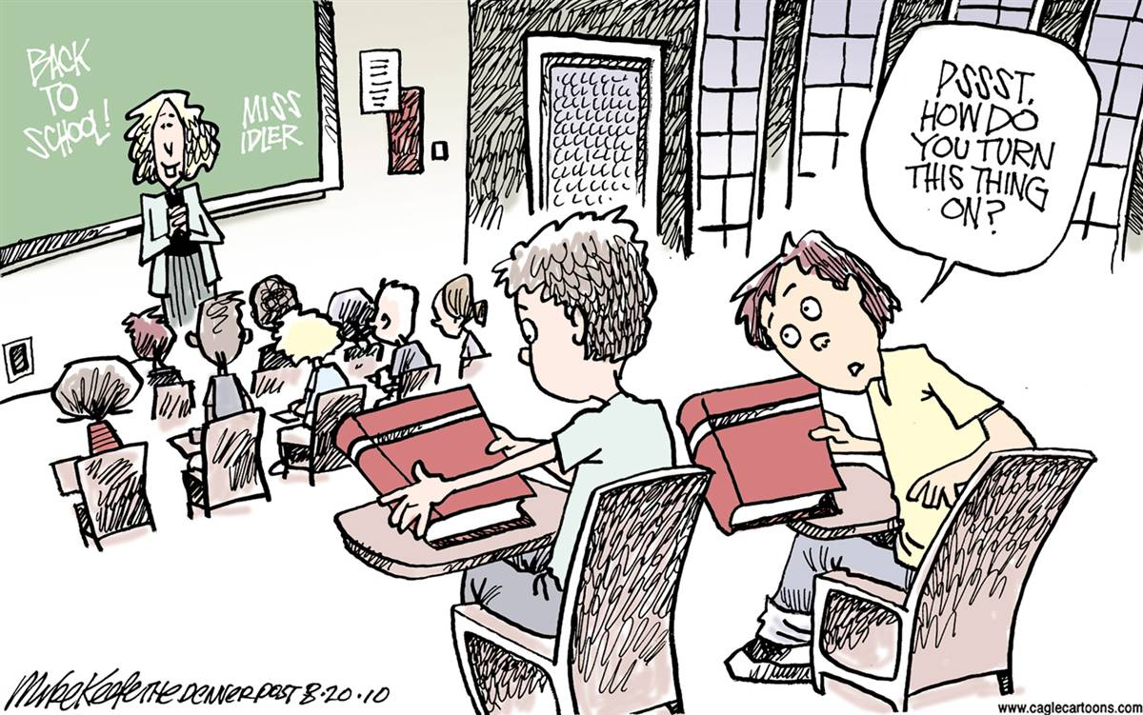
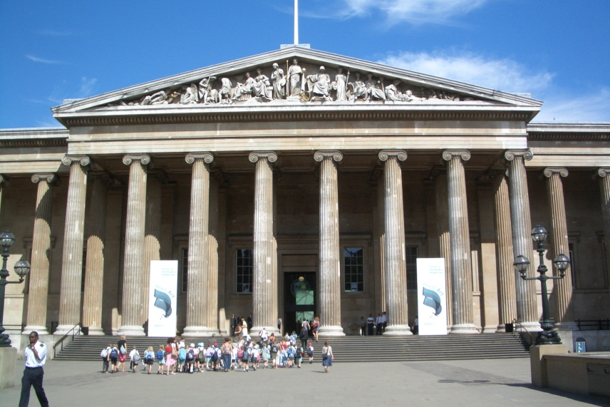
IMPROVING ECONOMIC EFFICIENCY
Providing Public Goods:
Roads, highways, bridges
Schools, museums, libraries

Slide 24
FOCUS QUESTION
WHY DO MARKETS FAIL AND WHAT CAN THE GOVERNMENT DO TO PREVENT THEM FROM FAILING?

