Slide 1
Econ Chapter 3
Demand

Slide 2
Demand
Demand is the amount of good or service that a consumer is willing and able to buy at various possible prices during a given time period.
Quantity Demanded describes the amount of a good or service that a consumer is willing and able to buy at each particular price during a given time period
Demand has two important conditions
The consumer must be willing AND able to buy the good or service.
Demand for the product must be examined for a SPECIFIC time period.

Slide 3
Law of Demand
Law of Demand: States that an increase in a good’s price causes a decrease in the quantity demanded and that a decrease in price causes an increase in the quantity demanded.
Three economic concepts explain the law of demand
Income effect
Substitution effect
Diminishing Marginal Utility

Slide 4
Income Effect
Income Effect
Purchasing Power: The amount of money or income, that people have available to spend on goods or services.
As purchasing power increases, his or her demand for goods or services increases.
Any increase or decrease in consumers purchasing power caused by a change in price is called the income effect.

Slide 5
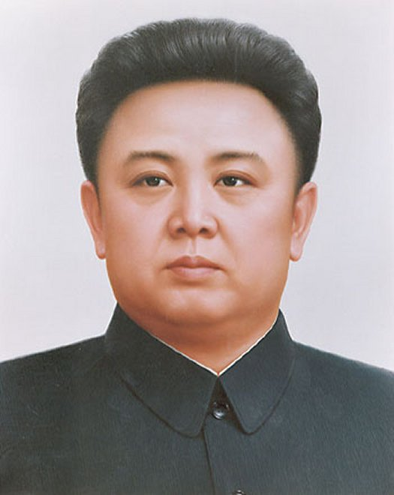
Substitution Effect
Substitution Effect
Describes the tendency of consumers to substitute a similar, lower priced product for another product that is relatively more expensive
Consumer demand for generic products is an example of the substitution effect

Slide 6
Diminishing Marginal Utility
Diminishing Marginal Utility
A product’s overall utility typically increases as more of a product is consumed.
As more units are consumed, the satisfaction from said product declines, also known as Diminishing Marginal Utility
Helps to explain why the demand for a product is NOT limitless.

Slide 7
Demand Schedule
Demand Schedule
Lists the quantity of goods that consumers are willing and able to buy at a series of prices
Demand Curves
Plots the information on a graph
A demand curve can show at a glance, the rate of change at each price.

Slide 8
Shifts
Factors can cause shifts in demand over time
Increase in demand can cause a shift to the right
Decrease in demand causes a shift to the left
Determinants of Demand include:
Consumer tastes and preferences
Market size
Income
Prices of related goods
Consumer expectations

Slide 9
Subs and Comps
Substitute goods
Goods that can be used to replace the purchase of similar goods when prices rise are called substitute goods
Example: When the price of butter goes up, the demand for Margarine, the substitute good, also goes up.
Complementary Goods
Goods that are commonly used with other goods
When the price of one good goes up, the quantity demanded for both goods decreases.
Example: Paint brushes and paint

Slide 10
Elasticity
Elasticity of demand is the degree to which changes in a good’s price affect the quantity demanded by consumers
Elastic Demand exists when a small change in a good’s price causes a major, opposite change in the quantity demanded.
Demand is elastic when a small decrease in a good’s price causes a significant increase or decrease in the quantity demanded
Inelastic Demand exists when a change in a good’s price has little impact on the quantity demanded.

Slide 11
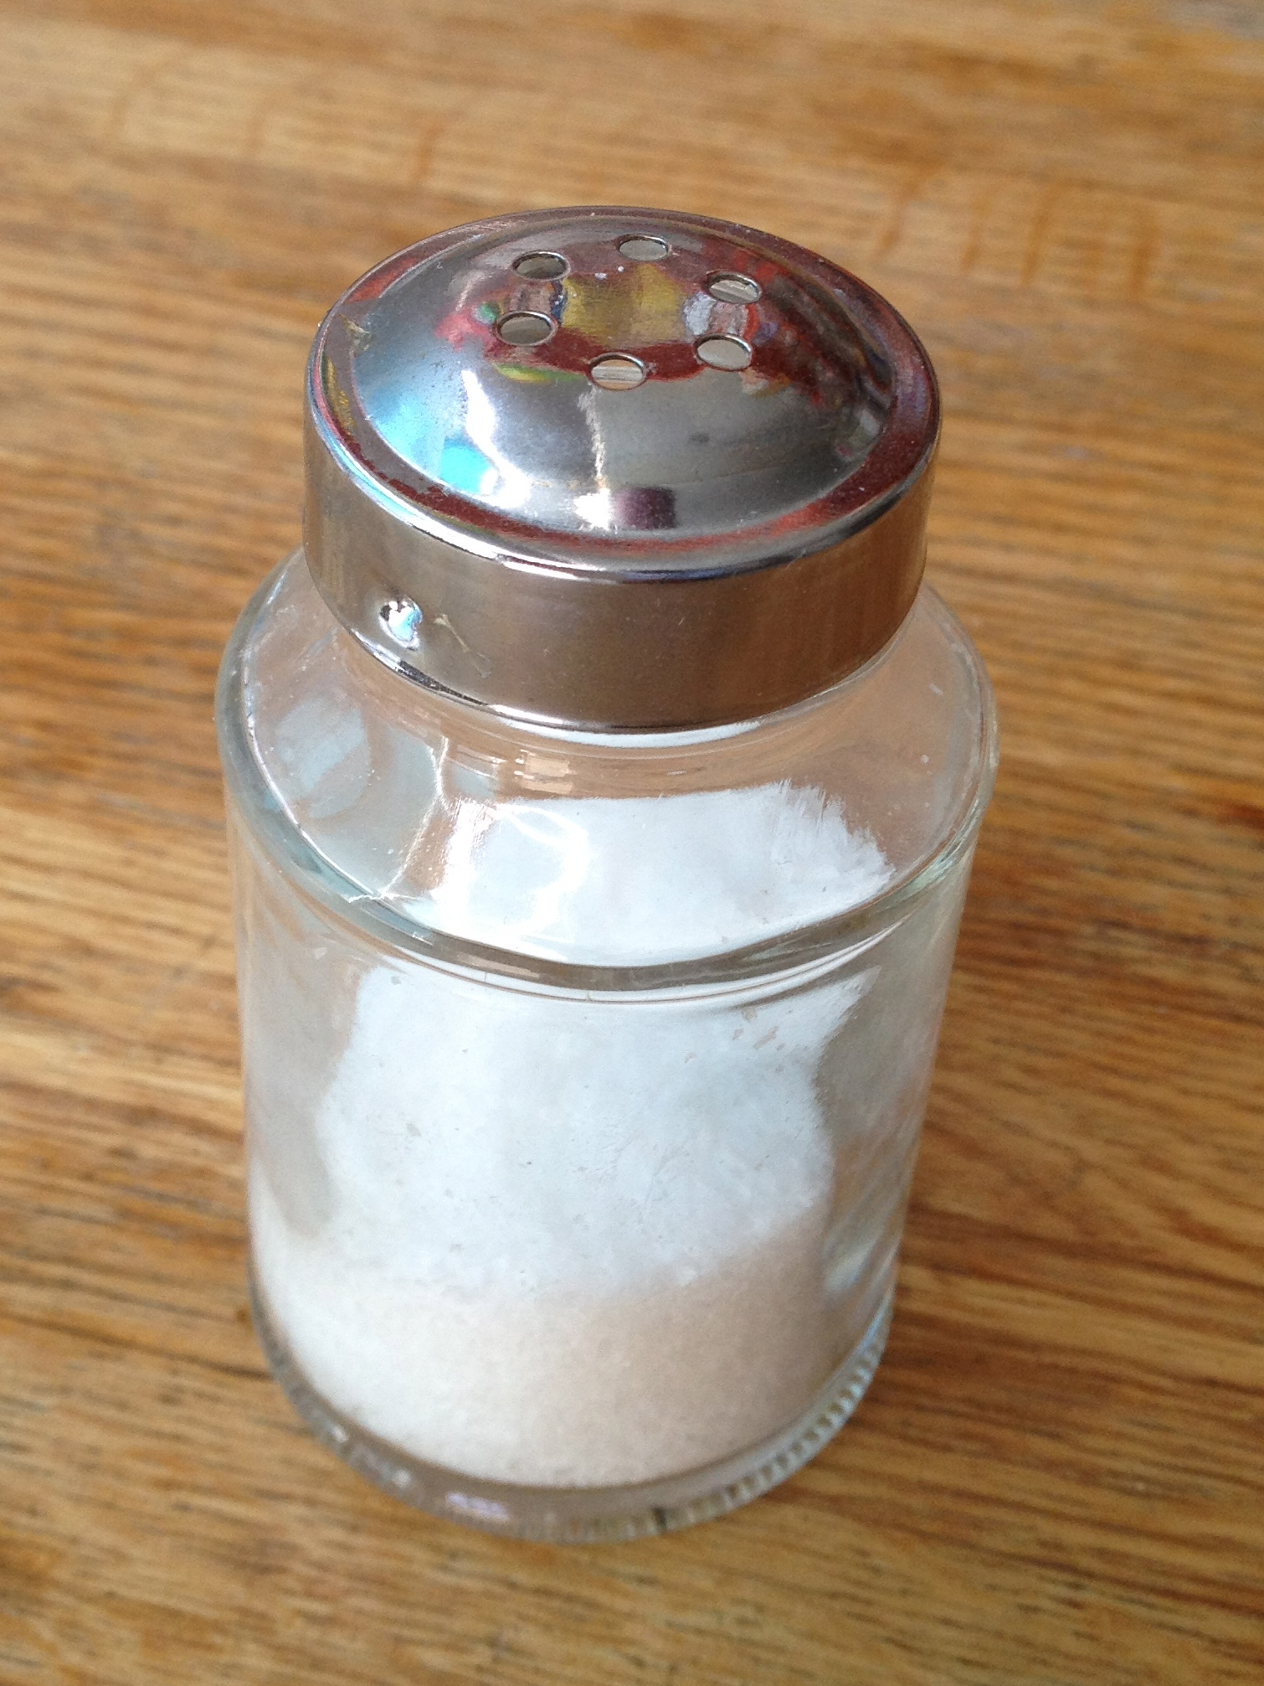
Inelasticity
A good usually has inelastic demand if
The product is a necessity
There are few or no readily available substitutes
The product’s cost represents a small portion of the consumer’s income

Slide 12
More elasticity
Measuring Elasticity
Total Revenue Test: Total income that a business receives from selling its products. By monitoring changes in a business’s total revenue before and after changes in the price of a product, you can determine the elasticity for a product.

