Slide 1
Chapter 20
Costs of Production

Slide 2
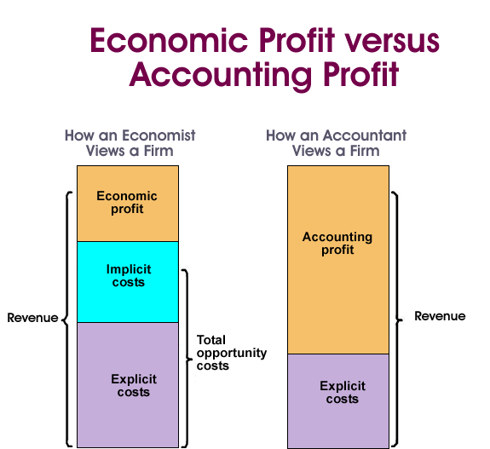
Economic Profits
Normal Profit: the minimum payment for your effort that you receive when you do business
Economic Profit: the total revenue minus economic costs. If total revenue exceeds its economic costs, it becomes an entrepreneur’s economic profit
Accounting Profit: the total revenue minus the implicit costs

Slide 3
Economic Costs
Explicit Costs: the monetary payments, or cash expenditures a firm makes to those who supply labor services, the materials, fuel, transportation services, etc. These are the concrete costs of production
Implicit Costs: the opportunity costs of using a firm self-owned, self-employed resources. They are money payments that self-employed resources could have earned in their best alternative use.
Economic Costs: is the cost when explicit and implicit costs are added together

Slide 4
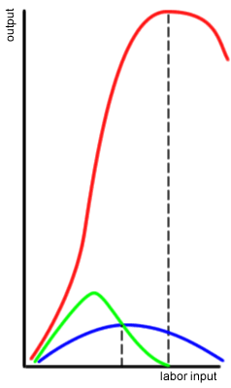
Short Run and Long Run
When the demand for a firms product changes, the firms profitability will depend on how quickly it can adjust its plant capacity. Because of this, there is the short run and long run
When talking about the short run and long run, three definitions you need to know are:
Total Product: the total quantity of a particular good or service produced
Marginal Product: the extra output or added product associated with adding a unit of variable resource to the production process
Marginal product= change in total product/change in labor input
Average Product: output per unit of labor input
Average Product= total product/units of labor
TP
MP
AP

Slide 5
Short Run
Short Run: a period too short for a firm to alter its plant capacity, but long enough to permit a change in the degree to which the fixed plant is used.
the firm can vary its output by applying larger or smaller amounts of labor, materials, and other resources to that plant
Law of Diminishing Returns: assumes that technology is fixed and thus the techniques of production do not change. As successive units of a variable resource are added to a fixed resource, beyond some point the extra, or marginal, product that can be attributed to each additional unit of the variable resource will decline
Only for the short run

Slide 6
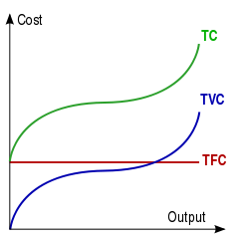
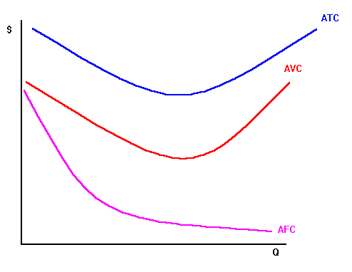
Short run total costs and average costs
Some resources are variable and some are fixed; fixed costs are independent of the level of output while variable costs vary with output
Total Cost= Total Fixed Costs + Total Variable Costs
Average fixed, average variable, and average total costs are fixed, variable, and total costs per unit of output. Average fixed costs decline continuously as output increases and is subject to the law of diminishing returns.
Average Total Costs = Average Fixed Costs + Average Variable Costs
Total Cost curve
Average Cost curve

Slide 7
Marginal Costs
The extra cost of producing one more unit of output. It is the amount by which total cost and total variable cost change when one more or less unit of output is produced
The Marginal Cost Curve
The marginal cost curve intersects the ATC and AVC curves at their minimum points

Slide 8
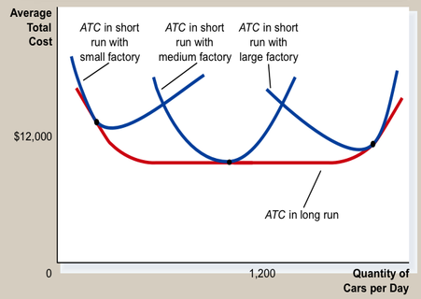
Long Run
The long run is a period of time sufficiently long for a firm to vary the amounts of all resources used, including plant size
All costs are variable
Long Run ATC Curve
The long run ATC curve is composed of segments of the short run ATC curves and represents the various plant sizes a firm can have in the long run

Slide 9
Economies and Diseconomies of Scale in the Long Run
Economies of Scale: reductions in the average total cost of producing a product as the firm expands its output
As plant size increases, a number of factors will, for a time, lead to lower average costs of production
Diseconomies of Scale: increases in the average total cost of producing a product as the firm expands the size of its plant in the long run
As firm size increases, higher average total costs may occur
Minimum efficient scale: lowest output level a firm can minimize long run average costs
Constant Returns to Scale: In some industries a wide range may exist between the economies of scale and diseconomies of scale, where cost does not change

Slide 10
Economies and Diseconomies of Scale Graph
On the left of this graph is the economies of scale, going into the minimum efficient scale, and ending at diseconomies of scale

