Slide 1
Chapter 18 Extensions to Supply and Demand
By
Lauren O’Brien, Peter Cervantes, Erik Borders

Slide 2
Price elasticity of Demand
Law of demand tells us consumers will buy more of a product when its price decreases and less when its price increases.
The responsiveness (or sensitivity) of consumers to a price change is measured by a product’s price elasticity of demand.
Modest price changes will have large changes in demand, while substantial changes hardly cause any change in demand
Things with a high demand change are elastic
Things with low demand change are inelastic

Slide 3
Price Elasticity Of Demand Formulas
This is the formula for exact measurements.
Exact measurements are inconsistent, so to find the average we use the midpoint formula.
Present the answer in absolute value

Slide 4
Interpretations Of Ed
Demand is elastic if a specific percentage change in price results in a larger percentage change in quantity demanded
Demand is inelastic if a specific percentage change in price results in a smaller percentage change in quantity demanded
Unit elasticity is the case where elastic and inelastic demand curves are separated and occurs where a percentage change in price and the resulting change in quantity demanded are the same.
Extreme cases where there is no responsiveness is perfect inelasticity. And the opposite of this is known as perfect elasticity.

Slide 5
Total-Revenue Test
Total revenue is the total amount a seller makes from the sale of a product in a particular time period.
Calculated with: TR= Price x Quantity
The total-revenue test is used to test whether demand is elastic or inelastic.
If TR changes in the opposite direction of price, demand is elastic. Vice-versa is inelastic.
If TR doesn’t change then it’s unit-elastic.
If demand is inelastic, decrease in price will reduce TR and vice-versa
If demand is unit-elastic, any chng in price will not affect TR

Slide 6
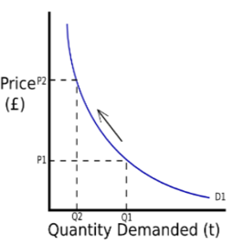
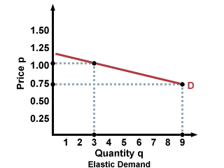
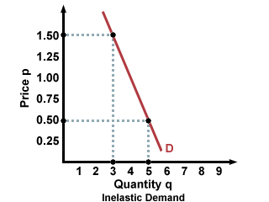
Total-Revenue Graphs
Elastic
Inelastic
Unit Elastic

Slide 7
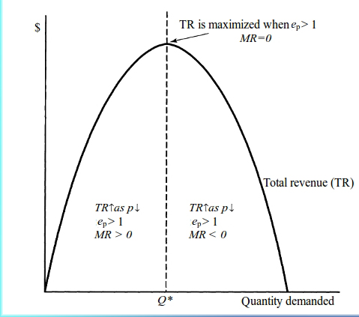
Price Elasticity and the Total-Revenue Curve
In the upper left segment of the demand curve, the percentage change in quantity is large because the original reference quantity is small.
In the lower right segment the percentage change in quantity is small because the original reference quantity is large.
Demand Curve Total Revenue Curve

Slide 8
Determinants of Price Elasticity of Demand
The larger the number of substitute goods that are available, the greater the price elasticity of demand.
The higher the price of a good relative to consumer incomes, the greater the price elasticity of demand.
The more that a good is considered to be a luxury rather than a necessity, the greater the price elasticity demand.
Generally, product demand is more elastic the longer the time period under considerstion

Slide 9
Applications of Price Elasticity of Demand
The demand for most farm products is highly inelastic, therefore an increase in output will decrease price and TR
Because a higher tax on a product with elastic demand will bring in less tax revenue, legislatures tend to seek out products that have inelastic demand when levying taxes.
The drug market has been seen as both elastic and inelastic depending on who you ask

Slide 10
Price Elasticity of Supply
If producers are relatively responsive to price changes, supply is elastic. If they are relatively insensitive to price changes, supply is inelastic.
If E_{s} is greater than 1, supply is inelastic
If E_{s} is less than 1, supply is elastic
If E_{s} equals 1, supply is unit-elastic
The degree of price elasticity of supply depends o how easily producers shift resources between alternative users.

Slide 11
Price Elasticity of Supply: The Market Period
The Market Period is the period that occurs when the time immediately after a change in market price is too short for producers to respond with a change in quantity supplied.

Slide 12
Price Elasticity of Supply: The Short Run
The short run in microeconomics is a period of time too short to change plant capacity but long enough to use fixed plant more or less intensively.

Slide 13
Price Elasticity of Supply: The Long Run
The long run in microeconomics is a time period long enough for firms to adjust their plant sized and for new firms to enter or leave the industry.

Slide 14
Cross Elasticity And Income Elasticity Of Demand
The cross elasticity of demand measures how sensitive consumer purchase of one product are to a change in price of some other product.
E _{xy} =% change in quantity demanded of X
^{% change in price of Y}
If cross elasticity of demand is positive, meaning that sales of X move in the same direction as a change in price of Y, then X and Y are substitute goods.
When cross elasticity is negative, an increase in the price of one decreases the demand for the other
A zero or near zero ross elasticity suggests that the two products being considered re unrelated or independent goods.

Slide 15
Income Elasticity Of Demand
Income elasticity of demand measures the degree to which consumers respond to a change in their incomes by buying more or less of a particular good.
E_{i} =percentage change in quantity demanded
^{Percentage change in income}
For superior or normal goods, the income elasticity coefficient is positive, meaning that more of them are demanded as income rises.
Inferior goods have a negative income elasticity coefficient, as consumers buy less of them as incomes rise.
Coefficient of income elasticity provide insights into the economy. For example, income elasticity helps to explain the expansion and contraction of industries.

Slide 16
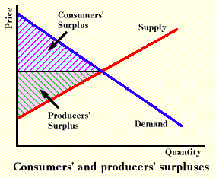
Consumer and producer surplus
Consumers and producers obtain “benefit surpluses” through market transactions.
Consumer surplus is the difference between the maximum price a consumer is willing to pay and the actual price.
Producer surplus is the difference between the actual price a product receives and the minimum acceptable price.

Slide 17
Efficiency Revisited
All markets have downward sloping demand curves and upward sloping supply curves yield consumer and producer surplus.
Productive efficiency is achieved because competition forces producers to use the best techniques and combinations of resources in producing product. Production costs in each level are minimized.
At the equilibrium price and quantity in competitive markets, marginal benefit equals marginal cost, maximum willingness to pay equals minimum acceptable price, the total of consumer and producer surpluses is maximized. These conditions each define allocative efficiency.
Quantities less than or greater than allocative efficiency level create efficiency losses, often called deadweight losses

Slide 18
The end

