Slide 1
Chapter 4
Supply

Slide 2
Supply definition
Supply is the quantity of goods and services that producers are willing to offer at various possible prices during a given time period.
Quantity supplied is the amount of a good or service that a producer is willing to sell at each particular price
Law of Supply: States that producers supply more goods and services when they can sell them a higher prices and fewer when they must sell them at lower prices.

Slide 3
Profit
Profit: The amount of money left over after producers have paid all costs
A business makes a profit when revenues are greater than the costs of production
Costs of Production: include wages, electricity, raw materials etc.
To make a profit, producers must provide goods and services that consumers want at prices they are willing to pay.

Slide 4
Schedule and graph
Supply Schedules
A tool that shows the relationship between the price of a good or service and the quantity that producers will supply.
The schedule lists each quantity that producers are willing to supply at various market prices
Supply Curves
Plots the information from a supply schedule on a graph

Slide 5
Elasticity
Elasticity of Supply
The degree to which price changes affect the quantity supplied
Elastic Supply exists when a small change in price causes a major change in quantity supplied. They are often;
Made quickly
Inexpensively
Using few, easily available resources
Suppliers can change the production rates of good easily in order to meet changing demands

Slide 6
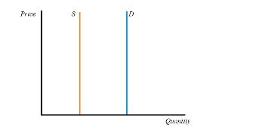
Inelastic
Inelastic Supply
Exists when a change in a good’s price has little impact on the quantity supplied
They usually require a lot of
Time
Money
Resources
Suppliers cannot easily change production rates

Slide 7
Determinants
Determinants of Supply
Also known as nonprice factors
Can shift the entire supply curve of a product
Include:
Prices of Resources

Slide 8
Government
Government Tools
Taxes: is a required payment of money to the government to help fund government services. Individuals and business pay taxes
Subsidies: Payments to private businesses by the government. Often used to encourage increase in supply of various products
Regulation: Rules about how companies conduct business. Designed to prevent pollution, discrimination and other problems

Slide 9
Technology
Technology
Competition
Increase in competition usually increases supply
Prices of Related Goods
Producer Expectations
A change in one of these determinants can cause a change in the overall supply of a product.

Slide 10
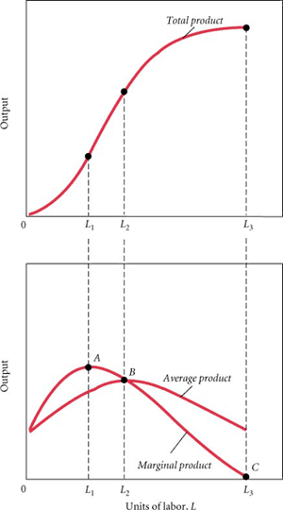
TP and MP
Total Product: Total output, or all of the product a company makes in a given amount of time with a given input.
Marginal Product: The change in output generated by adding one more unit of input. Used to maximize productivity

Slide 11
Diminishing returns
Law of Diminishing Returns: Describes the effect that varying the level of an input has on total and marginal product.
It states that as more of one input is added to a fixed supply of other resources, productivity increases up to a point.
At some point the marginal product will diminish
Eventually it will result in negative marginal product

Slide 12
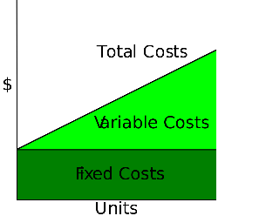
Costs
Fixed Costs
Production costs that don’t change
i.e. rent, interest on loans, insurance etc
Depreciation
Lessening in value of capital goods
i.e. cars, machines etc

Slide 13
Costs
Overhead
A company’s total fixed costs
Variable Costs
Change as the level of output changes
Raw materials and wages etc
Total Costs
The sum of the fixed and variable production costs
Marginal Costs
Additional costs of producing one more unit of output

