Slide 1
The Constitution
Chapter 2
O’Connor and Sabato
American Government:
Continuity and Change

Slide 2
The Constitution
In this chapter we will cover…
The Origins of a New Nation
The Declaration of Independence
The First Attempt at Government: The Articles of Confederation
The Miracle at Philadelphia: Writing a Constitution
The U.S. Constitution
The Drive for Ratification
Formal Methods of Amending the Constitution
Informal Methods of Amending the Constitution

Slide 3
The Origins of a New Nation
Colonists came to the New World during the 1600s for a variety of reasons including
to escape religious persecution,
to find plentiful land,
and to seek a new start in life.
The colonists were allowed significant liberties in terms of self-government, religious practices, and economic organization. (salutary neglect--British Crown policy of avoiding strict enforcement of parliamentary laws meant to keep American colonies obedient to England)

Slide 4
Trade and Taxation
The British followed a national policy of mercantilism. (Mother country develops commercial industry and favorable balance of trade.)
The colonists were outraged by the strict import/export controls, limits on western movement and taxation. Violent protests began.
The Sons of Liberty were organized by Samuel Adams and Patrick Henry to act out against the Crown.

Slide 5
First Steps Toward Independence
Stamp Act Congress: Included nine of the thirteen colonies in New York, 1765; representatives drafted a document for the king detailing how their rights had been violated.
Committees of Correspondence: Organizations set up in each of the colonies to provide information about the British and to help shape public opinion.

Slide 6
The First Continental Congress
The Continental Congress met in Philadelphia in September and October 1774.
They were not yet thinking of open rebellion.
They called for colonial rights of petition and assembly, trial by peers, freedom from a standing army, and the selection of representative councils to levy taxes.

Slide 7
The Second Continental Congress
King George refused the demands of the Continental Congress and tensions continued to rise.
Thus, the Second Continental Congress convened on May 10, 1775. Members were united in their hostility toward Britain.
King George sent 20,000 more troops and the Revolutionary War had begun.

Slide 8
The Declaration of Independence
On July 2, 1776 the colonies voted for independence (except New York, which abstained).
On July 4, 1776 the Congress adopted the Declaration of Independence penned mostly by Thomas Jefferson.
The Lockean philosophies that shaped the Declaration of Independence formed the theoretical basis for the new government.

Slide 9
The First Attempt at Government: The Articles of Confederation
Described a national government with a Congress empowered to make peace, coin money, appoint army officers, control the post, and negotiate with Native American tribes.
Retention of each state’s sovereignty.
One vote in the Continental Congress per state.
Nine states needed to pass any measure.
The selection and payment of delegates to Congress by their respective state legislatures.

Slide 10
Problems Under the Articles of Confederation
The Congress had no power to tax. States coined their own money and trade wars erupted.
Congress had no power to regulate commerce among the states or ensure a unified monetary system.
States conducted foreign relations without regard to neighboring states' needs or wants. Duties, tariffs, and taxes on trade proliferated with different ones in each state.

Slide 11
More Problems Under the Articles of Confederation
No provision for an executive branch responsible for implementing laws of Congress.
No provision for a judicial system applicable to all the states.
Failure to create a strong central government.

Slide 12
Daniel Shays’s Rebellion
In 1780, Massachusetts adopted a constitution that appeared to favor the wealthy.
Property-holding requirements for voting and office holding excluded the lower and middle classes. The economy worsened and banks foreclosed on farms. State then enacted law requiring payments of all debts in cash.
Outraged, former Revolutionary War captain Daniel Shays gathered 1,500 armed men and marched on the state court to prevent the loss of their farms.

Slide 13
More on Shays’s Rebellion
Congress authorized the Secretary of War to call up a national militia to respond and appropriated $530,000 for the purpose. Every state except Virginia refused.
Finally, a private army put down Shays's Rebellion.
This failure of Congress to protect the citizens and property of Americans was a glaring example of the weakness of the Articles, prompting several states to call for a convention to rewrite the Articles.

Slide 14
The Miracle at Philadelphia: Writing the Constitution
On February 21, 1787, Congress called for a Constitutional Convention in Philadelphia “for the sole and express purpose of revising the Articles of Confederation.”
In May, the convention met and the Virginia delegation suggested they throw out the Articles and devise a new system of government!
This act could be considered treason, so they adopted a pledge of secrecy.

Slide 15
Historians debate
Historians and political scientists have debated the framers’ motives
Economic (Charles Beard)
Religious and views on government
Social and economic (Jackson Turner Main)
Order and stability v. radical ideas (Gordon Wood)

Slide 16
The Virginia and New Jersey Plans
The delegates submitted plans for a new government.
The Virginia Plan proposed that sovereignty be vested in the people and not the states. Powerful central government with three branches, two-house legislature with one elected by the people and the other by state legislatures, legislature elects executive and judiciary.
The New Jersey Plan would have primarily strengthened the Articles by giving Congress the ability to raise revenues and would have kept a unicameral legislature chosen by state legislatures. A Supreme Court’s members are appointed for life by executive officers

Slide 17
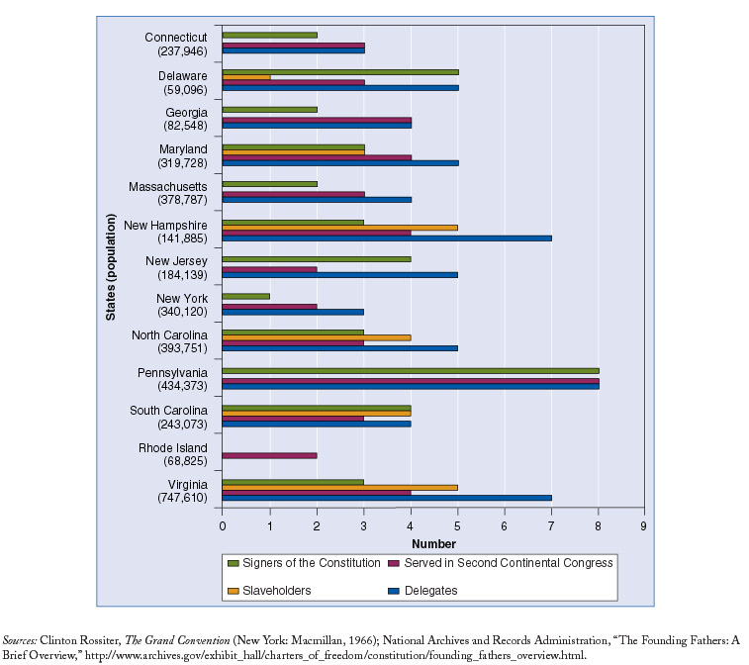
Who Were the Framers?

Slide 18
Constitutional Compromises
The Great Compromise: gave each state the same number of representatives in the Senate regardless of size.
Three-Fifths Compromise: stipulated that each slave was to be counted as three-fifths of a person for purposes of determining population as a basis for representation.
Executive (presidential term) four years and creation of Electoral College system

Slide 19
The U.S. Constitution
Federalism - power is divided among the states and the national government.
Separation of Powers – power was divided vertically through federalism and horizontally through separation of powers among the three branches of government.
Checks and Balances - The power of each branch of government is checked or limited and balanced by powers held by other branches.

Slide 20
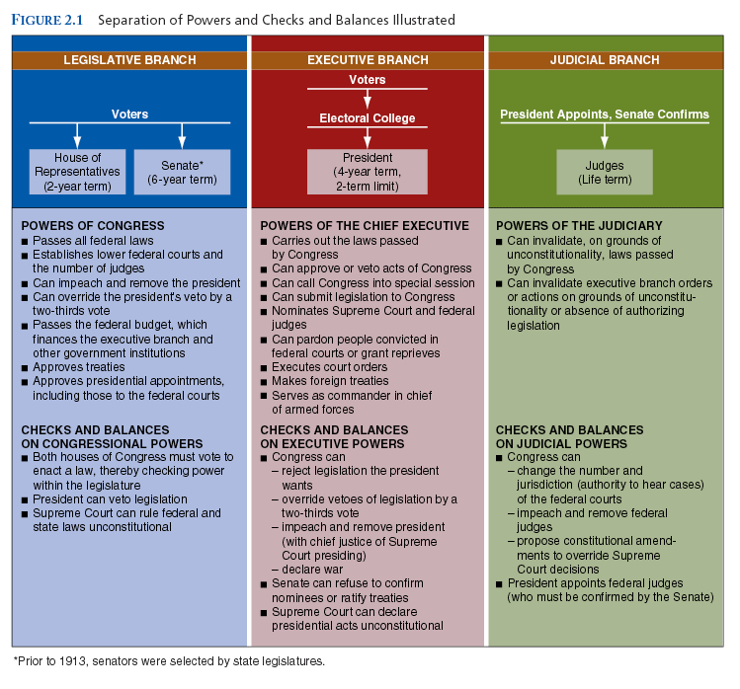

Slide 21
The Articles of the Constitution
Article I - establishes the legislative branch.
Article II - establishes the executive branch headed by the president.
Article III - establishes the judicial branch.
Articles IV – establishes the "full faith and credit clause" that mandates that states honor the laws and proceedings of another state.
Articles IV through VII - also include rules on the admission of new states to the union, how amendments can be added to the Constitution, prohibits religious tests for holding office, and set out procedures for the ratification of the document.

Slide 22
The Drive for Ratification
Federalists: favored a strong national government.
Anti-Federalists: favored strong state governments and a weak national government.

Slide 23
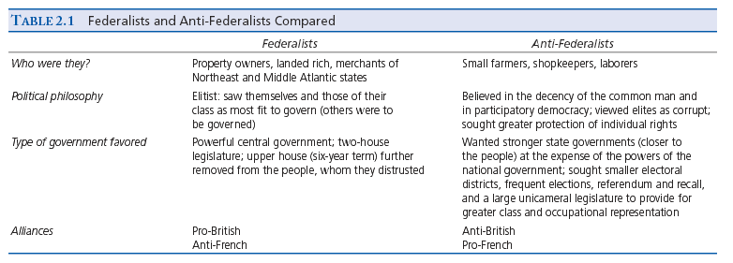

Slide 24
Formal Methods of Amending the U.S. Constitution
Article V creates a two-stage process for amending the Constitution: proposal and ratification.
An amendment can be proposed by two-thirds of both houses of Congress or…
by two-thirds of state legislatures requesting Congress to call a national convention to propose amendments.
An amendment can be ratified by a favorable vote in three-fourths of all state legislatures or by such a vote in specially called ratifying conventions called in three-fourths of the states.

Slide 25
Informal Methods of Amending the Constitution
Judicial Interpretation: in Marbury v. Madison (1803) the Supreme Court declared that the federal courts had the power to nullify actions of the national government if found to be in conflict with the Constitution.
Social, cultural and legal change

Slide 26
