Slide 1
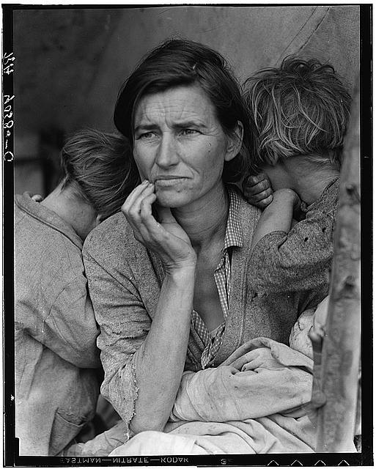
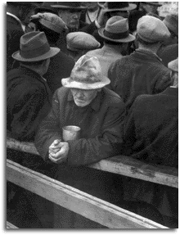
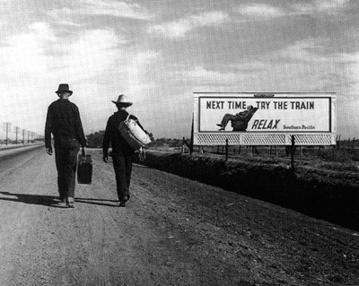
THE GREAT DEPRESSION BEGINS

Photos by photographer Dorothea Lange

Slide 2
Learning Objectives: Section 3 - Hoover Struggles with the Depression
1. Explain Hoover’s initial response to the Depression.
2. Summarize the actions Hoover took to help the economy and the hardship suffered by Americans.
3. Describe the Bonus Army and Hoover’s actions toward it.

Slide 3
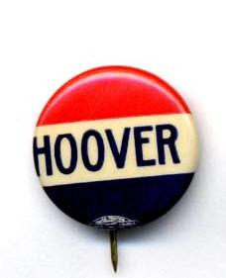
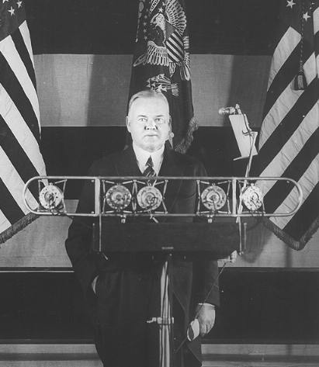
SECTION 3: HOOVER STRUGGLES WITH THE DEPRESSION

After the stock market crash, President Hoover tried to reassure Americans
He said, “Any lack of confidence in the economic future . . . Is foolish”
He recommended business as usual
Asked businesses not to lay off employees
Herbert Hoover

Slide 4

HOOVER’S PHILOSOPHY
Hoover was not quick to react to the depression
He believed in “rugged individualism” – the idea that people succeed through their own efforts
People should take care of themselves, not depend on governmental hand-outs
He said people should “pull themselves up by their bootstraps”
Hoover believed it was the individuals job to take care of themselves, not the governments

Slide 5
Chapter 14: Section 3
Guided Reading Questions
What was Hoover’s philosophy of government?
  He believed that a chief function of govt was to encourage voluntary cooperation among competing interest groups;
  He believed that federal govt should guide relief measures but not directly participate in them

Slide 6
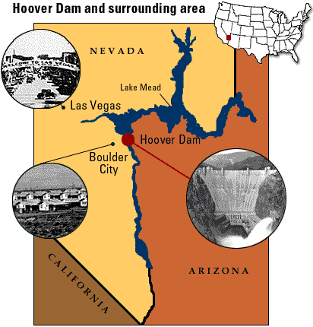
HOOVER’S SUCCESSFUL DAM PROJECT
Hoover successfully organized and authorized the construction of the Boulder Dam (Now called the Hoover Dam)
The $700 million project was the world’s tallest dam (726 feet) and the second largest (1,244 feet long)
The dam currently provides electricity, flood control and water for 7 western states

Slide 7
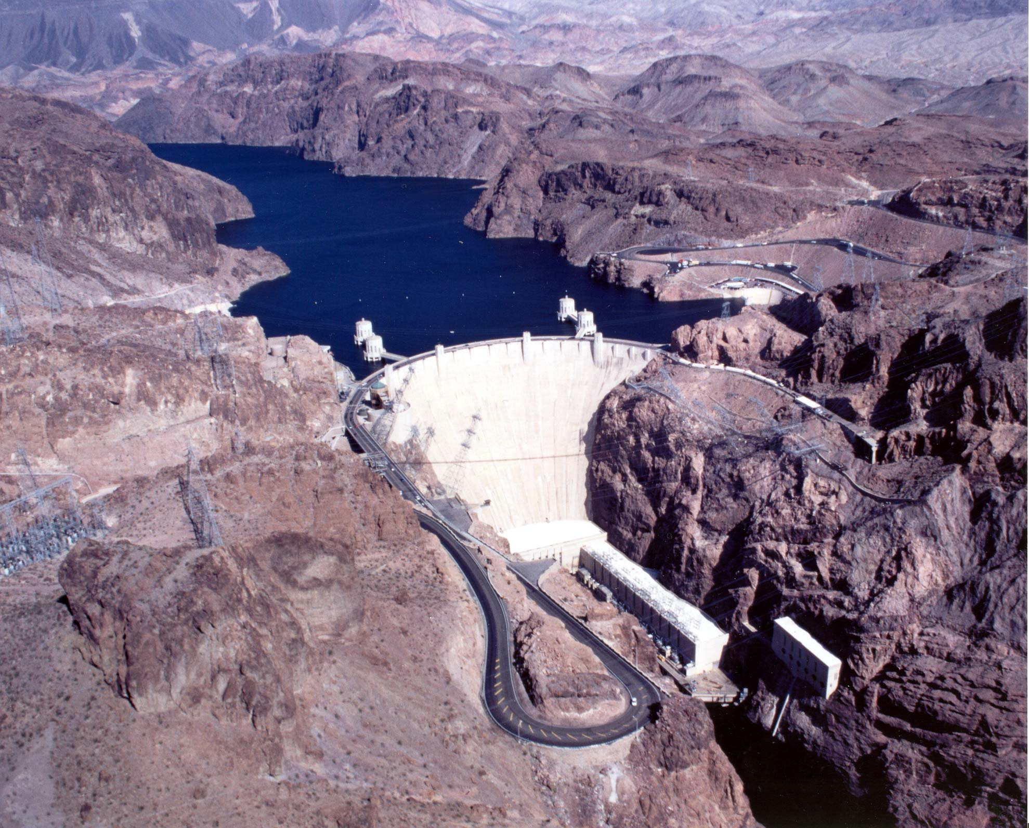
Any dam questions?

Slide 8
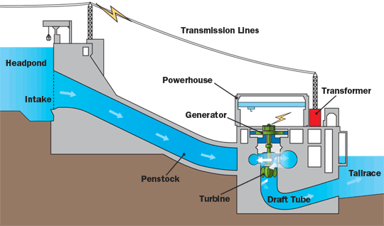

Slide 9

HOOVER TAKES ACTION: TOO LITTLE TOO LATE
Hoover gradually softened his position on government intervention in the economy
He created the Federal Farm Board to help farmers
He also created the National Credit Organization that helped smaller banks
His Federal Home Loan Bank Act and Reconstruction Finance Corp were two measures enacted to protect people’s homes and businesses
Hoover’s flurry of activity came too late to save the economy or his job

Slide 10
Chapter 14: Section 3
Guided Reading Questions
Responses and Economics Results
What was Hoover’s initial reaction to the stock market crash of 1929?
  CAUTION: urged key leaders to work together to provide solutions and to act in ways that would not make the economic situation worse.

Slide 11
Chapter 14: Section 3
Guided Reading Questions
What was the nation’s economic situation in 1930?
  Continued to worsen;
  More companies went out of business;
    Unemployment continued to rise;
  Soup kitchens, shantytowns, and hoboes became common;
    The misery to ordinary people continued to grow

Slide 12
Chapter 14: Section 3
Guided Reading Questions
How did voters in 1930 respond to this situation?
  Republicans lost control of the House of Representatives.
  Saw their majority in the Senate dwindle to one vote.

Slide 13
Chapter 14: Section 3
Guided Reading Questions
What did Hoover do about the economic situation?
  Directed federal funds into public works projects,
    such as Boulder/Hoover Dam, to jump-start the economy and create jobs;
  Backed a series of federal programs,
    including the Federal Farm Board, the National Credit Corporation, the Glass-Steagall Banking Act, the Federal Home Loan Bank Act, and the Reconstruction Finance Cooperation.

Slide 14
Chapter 14: Section 3
Guided Reading Questions
How did the economy respond to his efforts?
  Economy continued to deteriorate

Slide 15
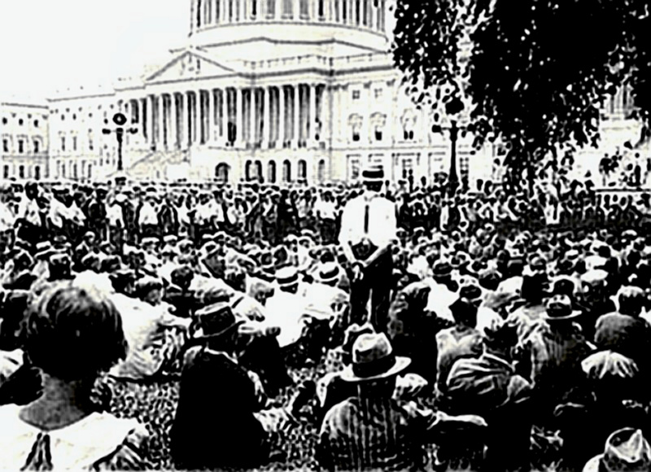
BONUS ARMY

A 1932 incident further damaged Hoover’s image
Known as the Bonus Army: 15,000 World War I vets and their families arrived in Washington to support a proposed bill

Slide 16
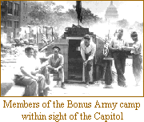
BONUS ARMY
The Patman Bill would have authorized Congress to pay a bonus to WWI vets immediately
The bonus was scheduled to be paid in 1945 --- The Army vets wanted it NOW

Slide 17
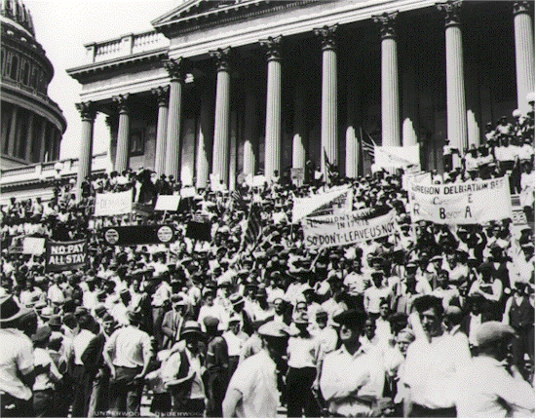
BONUS ARMY TURNED DOWN
Hoover called the Bonus marchers, “Communists and criminals”
On June 17, 1932 the Senate voted down the Putnam Bill
Thousands of Bonus Army soldiers protest – Spring 1932

Slide 18
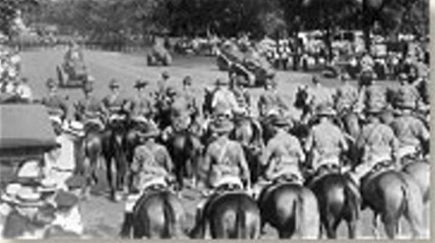
BONUS MARCHERS CLASH WITH SOLDIERS
Hoover told the Bonus marchers to go home– most did
2,000 refused to leave
Hoover sent a force of 1,000 soldiers under the command of General Douglas MacArthur and his aide Dwight Eisenhower

Slide 19
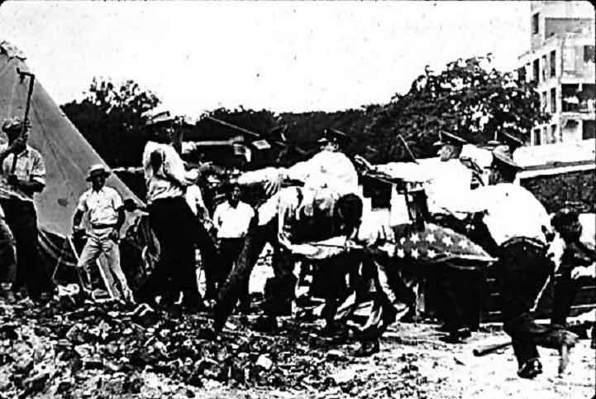
AMERICANS SHOCKED AT TREATMENT OF WWI VETS
MacArthur’s 12th infantry gassed more than 1,000 marchers, including an 11-month old baby, who died
Two vets were shot and scores injured
Americans were outraged and once again, Hoover’s image suffered

Slide 20
Chapter 14: Section 3
Guided Reading Questions
How did Hoover deal with the economic problem posed by the Bonus Army?
  Opposed immediate payment of bonuses to WWI veterans;
  Ordered the U.S. Army to close their Capitol Hill shantytown,
    leading to the gassing of 1,000 people,
    a baby’s death and
    public outrage.

Slide 21
Chapter 14: Section 3
Guided Reading Questions
How did his efforts effect his own political situation?
  Damaged his public image;
  Assured the victory of Democratic candidate in the 1932 presidential election
    Franklin Delano Roosevelt

Slide 22
Chapter 14: Section 3
MAIN IDEA QUESTIONS
How did Hoover’s treatment of the Bonus Army affect his standing with the public?
  After the Bonus Army incident, Hoover's approval rating started to drop.
  The public was very disheartened by his actions.

Slide 23
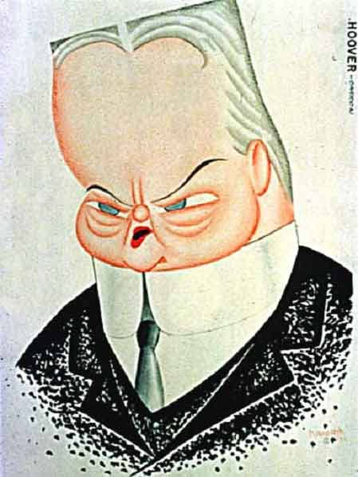
Hoover had little chance to be re-elected in 1932

Slide 24
Chapter 14: Section 3
MAIN IDEA QUESTIONS
In what ways did Hoover try to use the government to relieve the Depression?
  Hoover set up the Reconstruction Finance Corp. to bring federal aid to hard pressed banks and businesses.

Slide 25
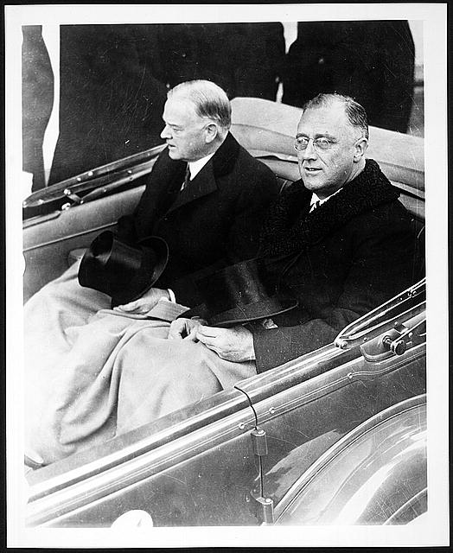
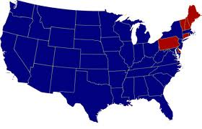

1932 Herbert Hoover ran against Franklin Delano Roosevelt (FDR) and lost

Slide 26
Chapter 14: Section 3
MAIN IDEA QUESTIONS
A – What were some of Hoover’s key convictions about government?
  He believed that reason could solve problems,
  That govt should foster cooperation between competing groups,
  That individuals, charities, and private organizations should help care for the less fortunate.

Slide 27
Chapter 14: Section 3
MAIN IDEA QUESTIONS
B – Why do you think people blamed Hoover for the nation’s difficulties?
  Americans look to their leaders for results, and Hoover wasn’t getting results.

Slide 28
Chapter 14: Section 3
MAIN IDEA QUESTIONS
C – What were some of the projects proposed by Hoover, and how effective were they?
  Federal Farm Board;
  National Credit Corporation;
  Federal Loan Bank Act;
  Reconstruction Finance Corporation.
  These projects and measures were not able to turn the economy around.

Slide 29
Chapter 14: Section 3
MAIN IDEA QUESTIONS
D – What did the Bonus Army want?
  As Veterans of WWI they had been promised a cash bonus.

