Slide 1
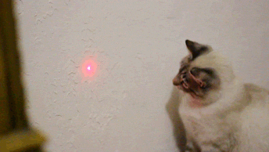
Chapter 19
Consumer Behavior and Utility Maximization

Slide 2
Utility
Utility - the satisfaction one gets from consuming a product; subjective; measured in utils
Total Utility - total amount of satisfaction derived from consuming specific quantity
Marginal Utility - extra satisfaction derived from consuming an additional unit, change in total utility

Slide 3
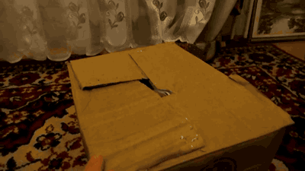
More About Utility
Utility and usefulness are not synonymous.
Paintings by Picasso offer great utility to art connoisseurs but are useless functionally
Utility is subjective: it varies from person to person
Utility is difficult to quantify but we assume people can measure it with utils (units of utility)

Slide 4
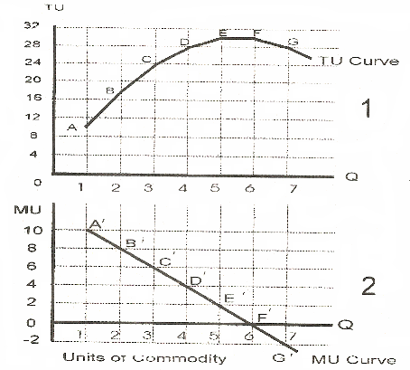
marginal utility = slope of total utility
marginal utility:
decreases as total utility increases in an arc upward
equals 0 when total utility reaches its maximum
is negative when total utility is decreasing
marginal utility = slope of total utility
marginal utility:
decreases as total utility increases in an arc upward
equals 0 when total utility reaches its maximum
is negative when total utility is decreasing

Slide 5
Law of Diminishing Marginal Utility
As consumer acquires additional units of product, satisfaction declines
Consumers can obtain as much as they can afford but the more the acquire, the less they want it
accounts for downsloping demand curve
Consumers will not buy more of product that is becoming less and less desirable unless the price falls

Slide 6
different rates in decline of marginal utility
results in different selling techniques by companies
ex) newspaper dispensers
- allow consumer to access entire stack
-company trust consumer to only take one bc there’s zero marginal utility of second unit
+ not worth selling, undesirable by next day
vs. vending machine
-much slower decline in marginal utility

Slide 7
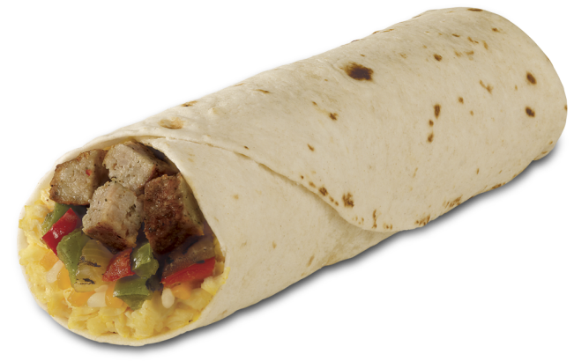
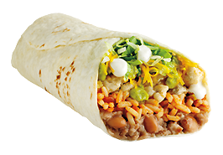
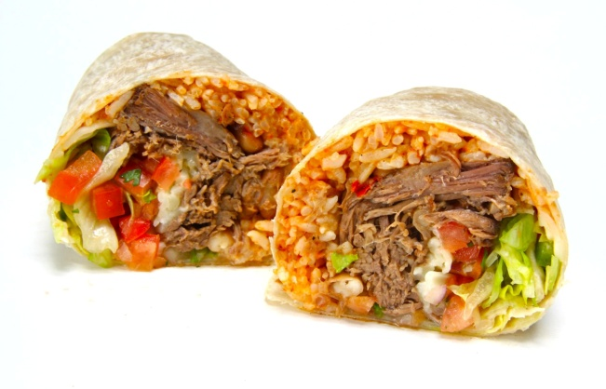
Theory of Consumer Behavior
assume of typical consumer:
rational behavior
preferences
budget constraint
prices, independent of the amount purchased

Slide 8
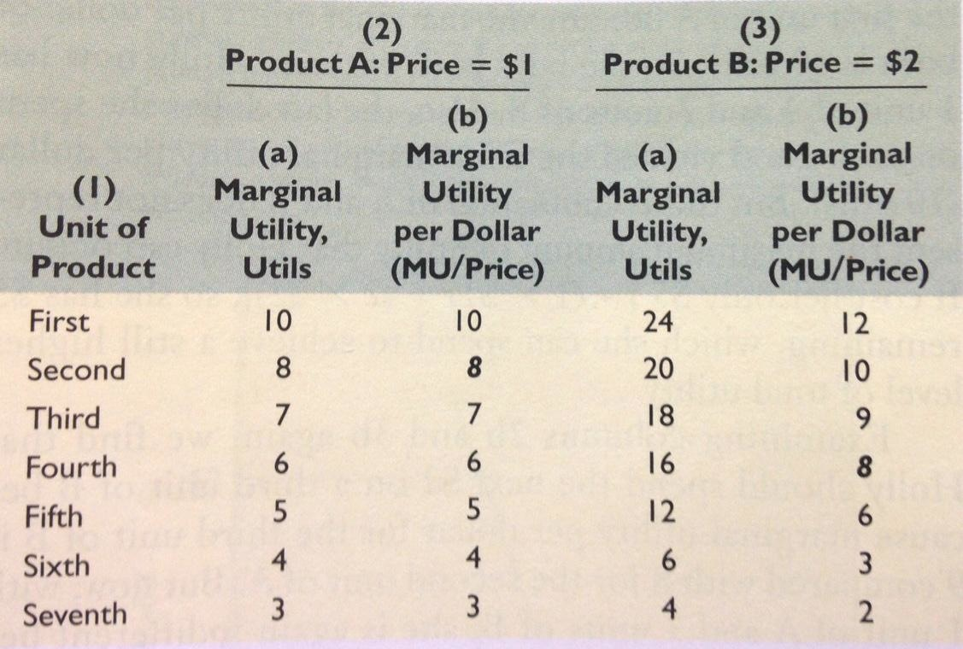
Utility Maximizing Rule
consumer should allocate income so last dollar spent on each product yields same amount of marginal utility
table: consumer should purchase 2 units of product A and 4 units of product B to yield greatest utility

Slide 9
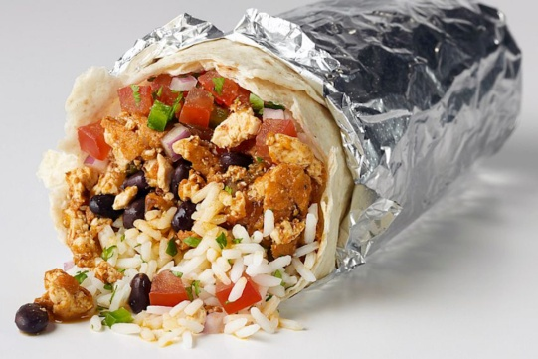
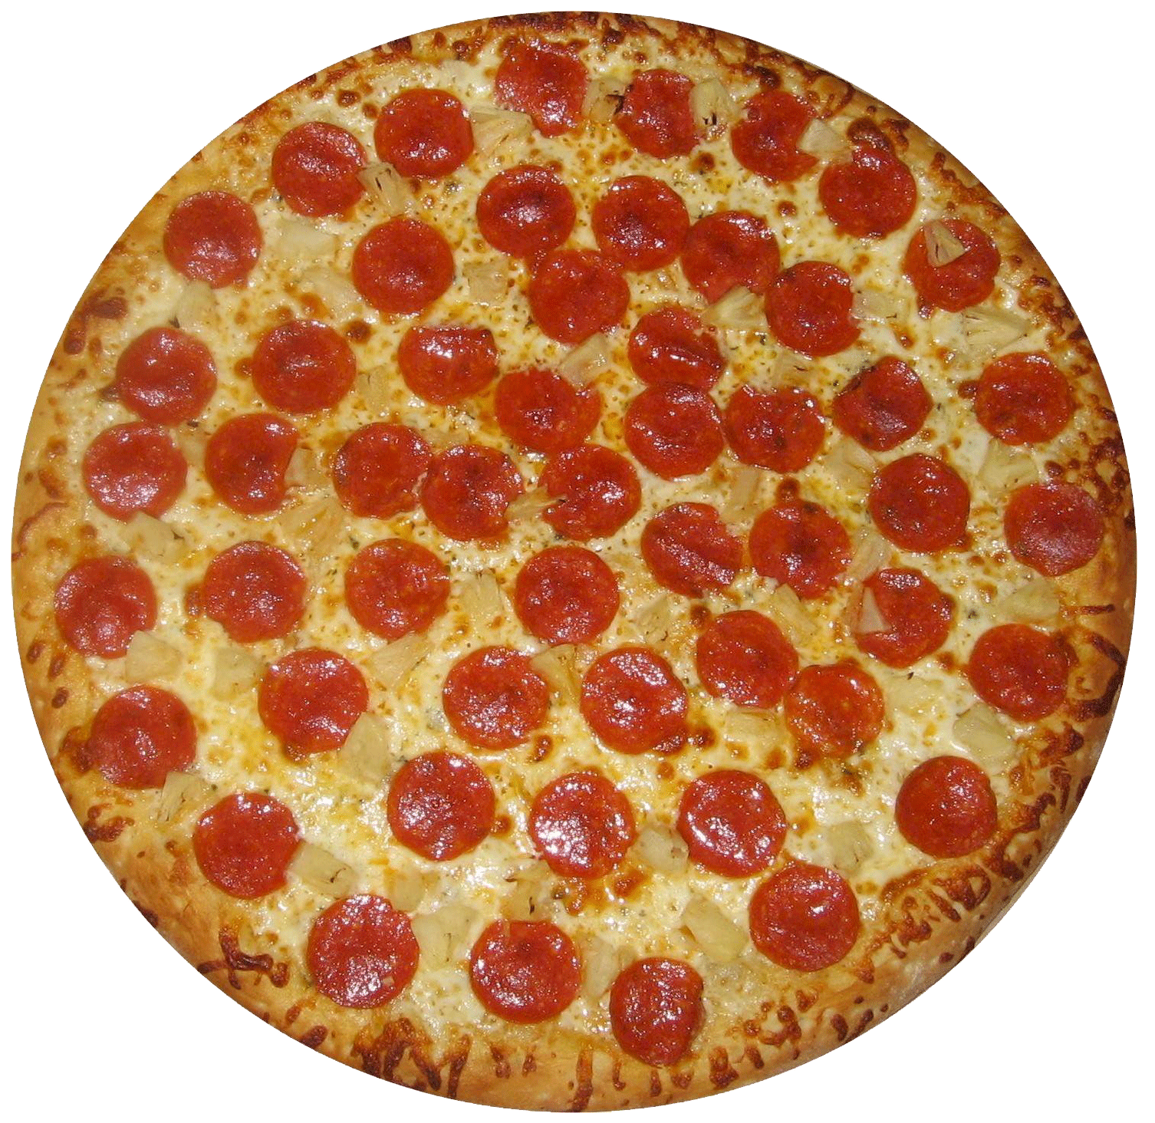
To apply this last example in real terms, to achieve maximum utility a person should consume 2 pizzas
and 4 burritos

Slide 10
Algebraically
MU of product A = MU of Product B
Price of A Price of B
if one side is less than other, consumer should allocate more money to that side and less to other to achieve equality

Slide 11
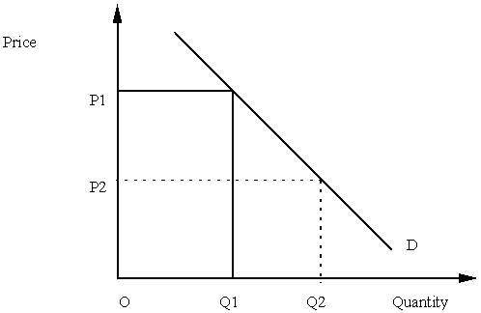
Utility Maximization and Demand
The demand curve shows the amount of a unit that is demanded at each price to achieve maximum utility.
For example, for unit B at P1 of $2, 4 burritos would be demanded but if the price dropped to P2 of $1 6 burritos would be demanded
As price drops, more quantity is demanded because a consumer therefore has more money to spend on the product

Slide 12
Income Effect
Income effect is the impact that a change in the price of a product has on a consumer’s real income and consequently on the quantity demanded of that good.
In the example of a price decline from $2 to $1 for unit B, a consumer would then be able to purchase 4 burritos for only $4 instead of $8. The consumer then has an extra $4 that increases real income.
The income effect is the extra amount of B a consumer decides to purchase because the decline in the price of B raised their real income

Slide 13
Substitution Effect
Substitution Effect is the impact that a change in a product’s price has on its relative expensiveness and consequently on the quantity demanded.
When the price of unit B, burritos, decreases the last dollar spent on B yields 16 utils while the last dollar spent on A yields only 8 utils. Therefore we are out of equilibrium
A switching of purchases from A to B is needed to restore equilibrium; a substitution of now cheaper B for A will occur when the price of B drops.

Slide 14
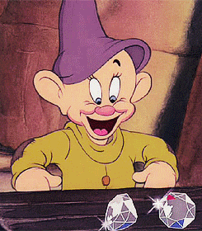
Real Life Applications
Many consumers substitute DVD players for VC players because of increased utility.
The diamond-water paradox: water has a low marginal utility but diamonds have a high one.
Non-cash gifts have less utility than cash gifts because the buyers do not have the same tastes as the recipients.

Slide 15
Jeopardy Game
https://docs.google.com/presentation/d/1odi4b2-l0DxijMs0VfXLY5AzylxG9bZyd4A_45S1oBM/edit#slide=id.g2af4f3288_042

