Slide 1
Market Structure Wrap-Up

Slide 2
4 Market Structures
Maximize Profit
When:
MR = MC
MR = MC
MR = MC
MR = MC
Equilibrium
Price vs. MC
P = MC
P > MC
P > MC
P > MC
Perfect
Competition
Monopolistic
Competition
Oligopoly
Monopoly
Long Run
Economic
Profit
Yes
No
No
Yes
Demand
& Marginal
Revenue
Curve

Slide 3
Example: Monopoly Equilibrium
To Find Equilibrium:
Set MC = MR
Line up to Demand Curve
Opportunity Costs:
Lower QTY
Higher Price
Deadweight Loss

Slide 4
Every Dominant Strategy is a Nash Equilibrium
BUT: Every Nash Equilibrium is not a dominant strategy
Liz
HIGH
LOW
HIGH | 400, 300 | -800, 500
LOW | 600, -800 | -500, -500
Bob
Easy way to solve Nash Equilibrium:
First, Circle each players preferred boxes
Second, if 2 circles in same row = a Nash Equilibrium exists

Slide 5
SHORT RUN: Monopolistic Competition
LONG RUN: Monopolistic Competition

Slide 6
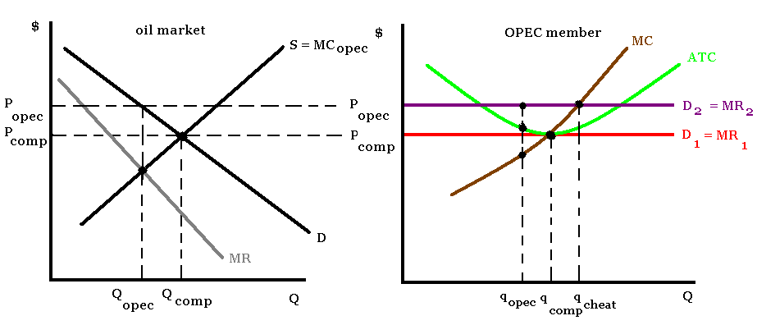
Oil Market: Perfect Competition vs. Oligopoly

