Slide 1
Short run production
By big money and the Russian

Slide 2
Short run graph

Slide 3
Fixed costs
Rent: $2,700/month
Electricity: $1,500/month
Gas: $200/month
Cable: $100/month

Slide 4
Variable costs
Labor: $10.00/hr
Food Supplies: $2.43/burrito
Sales Tax: $0.22/burrito

Slide 5
Burrito breakdown
Tortilla: $0.15
Rice: $0.50
Beans: $0.09
Meat: $0.50
Cheese: $0.18
Avocado $0.66
Lettuce: $0.02
Tomato: $0.25
Sour Cream: $0.05
Hot Sauce: $0.03
One Burrito: Priceless

Slide 6
Short run vs. Long run

Slide 7
Short run limits

Slide 8
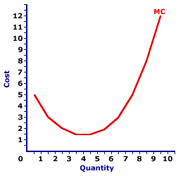
Marginal costs (mc)
The cost to produce one more of a product

Slide 9
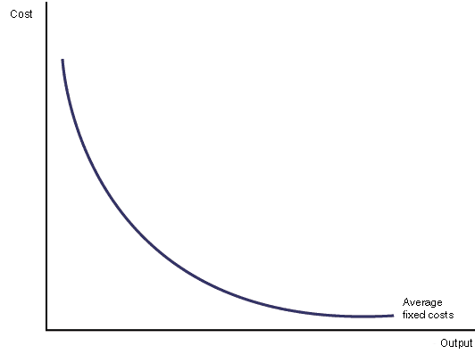
Average fixed costs (afc)
Total Fixed Costs/number of units produced

Slide 10
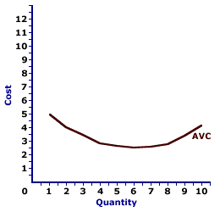
Average variable costs
Total Variable Costs/number of units produced

Slide 11
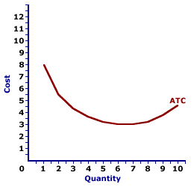
Average total costs
Fixed costs + Variable Costs/ number of units produced
or
AVC +AFC

Slide 12
Shutdown: If less than q2

Slide 13
Operate at loss: q2-q4

Slide 14
Short run profit: Quantity>q4

Slide 15
Long run equilibrium: at q4

Slide 16
DATA
Quantity
1
2
3
4
5
6
7
8
9
10
AFC
150
75
50
37.5
30
25
21.4
18.75
16.67
15
AVC
82.5
42.5
29.16
22.5
18.5
28.75
29.16
22.19
29.16
26.5
ATC
232.5
117.5
79.16
60
48.5
53.75
51.56
40.94
35.83
31.5

Slide 17
Production cost graph

Slide 18
How did we get all that….Data!?
Fixed Cost:
$4,500/month
$150/day
AFC:
150/quantity

Slide 19
Variable costs
$2.50/burrito
$10/hour/employee
$80/employee/day
Law Diminishing Returns:
First Employee: 5 burritos
Second Employee: 3 burritos
Third Employee: 2 burritos

Slide 20
Variable costs (cont.)
AVC: variable cost/ quantity
Notes:
Big money

Slide 21
Average total cost
AFC+AVC=ATC
150+82.5=232.5
or
Fixed costs + Variable costs/ Quantity

