Slide 1
Price Discrimination
Monopoly Wrap-Up
Chapter 15 Completion

Slide 2
PRICE DISCRIMINATION
Price discrimination is the business practice of selling the same good at different prices to different customers
For a Firm to price discriminate it must:
have some market power (some price control)
be able to identify & separate groups of consumers
be able to prevent resale between consumers

Slide 3
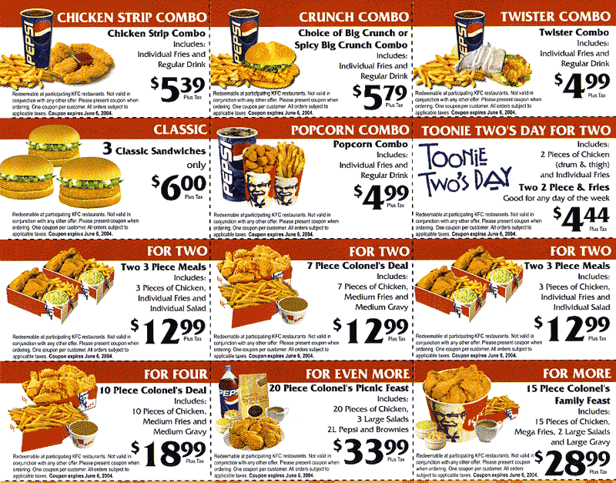
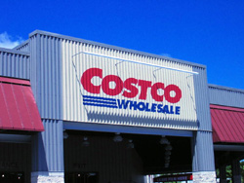
Examples of Price Discrimination
Coupons
Cell Phone “Calling Plans”
Shoppers who “buy in bulk”

Slide 4
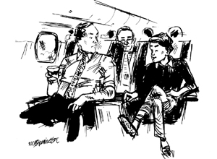
http://www.hulu.com/watch/46550/cnbc-originals-inside-american-airlines
“Would it bother you to hear how little I paid for this flight?”

Slide 5
Single Price Monopoly
Costs and
Despite a monopoly profit, many consumer still pay less than they are willing to…
Revenue
MC
P₁
E₁
Monopoly
ATC
Profit
ATC
D
MR
0
Q₁
Quantity

Slide 6
“Imperfect” Price Discrimination
It always raises monopolist profits
By charging higher prices to some customers
It can lower deadweight loss
It can raise, lower or leave Total Welfare unchanged

Slide 7
Imperfect Price Discrimination
Costs and
Simply charge some customers more than P₁ and profits will rise!
Revenue
MC
P₁
E₁
Monopoly
ATC
Profit
ATC
D
MR
0
Q₁
Quantity

Slide 8
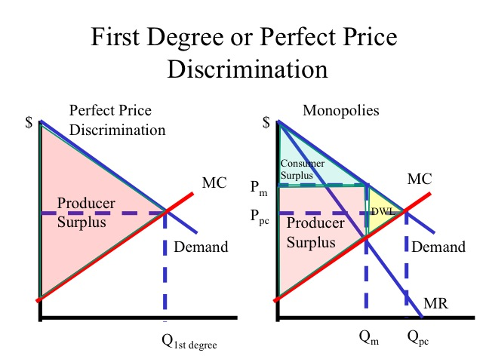
Perfect Price Discriminating
Each Consumer pays the maximum price they are willing!
Consumer surplus & deadweight loss are eliminated!
Every consumer is charged a different price so the demand curve is the MR curve!

Slide 9
Worksheet
Price Discrimination

Slide 10
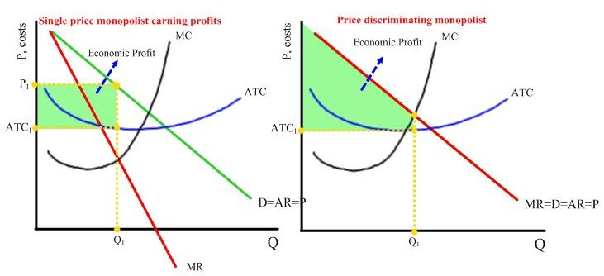

Slide 11
Monopolies & Elasticity
Unit Elastic
Elastic range
Inelastic Range
●
-----------------
D
Monopolies will:
Operate only in Elastic Portion of Demand
Elasticity = 1 when MR = 0
MR

