Slide 1
Oligopoly Pricing
Chapter 16 completion

Slide 2
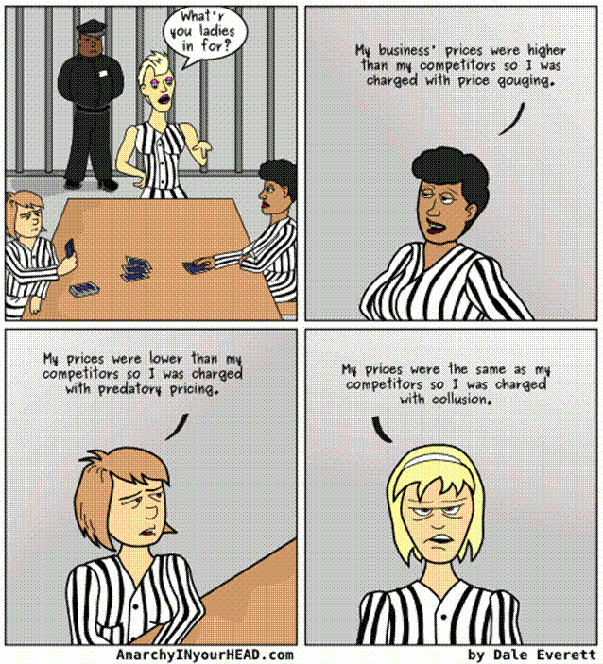
Illegal Pricing Practices
.
.
.

Slide 3
Price Fixing
Price fixing is using collusion among competitors to fix prices
If firms cooperate prices rise toward monopoly prices
This is illegal according to Anti-Trust Laws

Slide 4
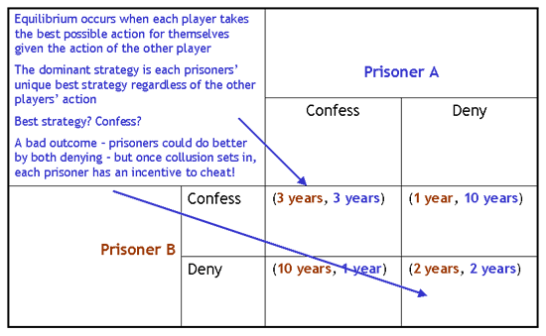
Prisoner’s Dilemma Analysis
Illustrates that self-interest can prevent people from maintaining cooperation
even when cooperation is in their mutual self-interest

Slide 5
Why People Sometimes Cooperate
Firms that care about future profits will cooperate in repeated games rather than cheating in a single game to achieve a one-time gain

Slide 6
NASH EQULIBRIUM
Coke
Advertise
Don’t Advertise
Advertise | 80, 80 | 120, 45
Don’t Advertise | 45, 120 | 100,100
Pepsi
When each player has chosen a strategy
that is best for them given the action taken
by other players (non-cooperative equilibrium)
Nash Equilibrium
Defined
Every Dominant Strategy is a Nash Equilibrium
Every Nash Equilibrium is not a dominant strategy

Slide 7
Game Theory
Handout

Slide 8
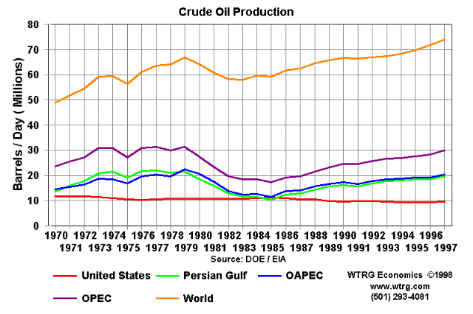
Concentration Ratio
Measure of the % of market 4 firms control
Economists believe 40% & higher is the standard for oligopolies
4 Firm Concentration Ratio
Cigarettes 99%
Batteries 90%
Breweries 89%
Light Bulbs 89%
Cereals 83%
OPEC = 50%

Slide 9
Article: Rise of Oligopolies
Why Now? Benefits Costs

Slide 10
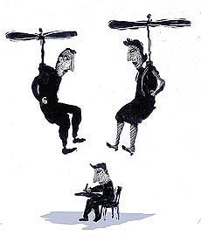
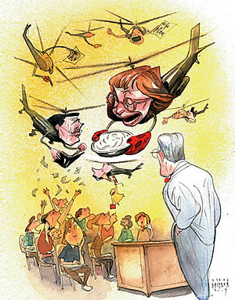
Echo Boomers
They already make up nearly one-third of the U.S. population, and
already spend $170 billion a year of their own and their parents' money.

Slide 11
Is the USA in Decline?
http://www.pbs.org/newshour/video/share-ms.html?s=news01p793

Slide 12
Oligopolies: Maximizing Profit
Oligopolists could maximize profits by forming a cartel & acting like a monopolist
However, if oligopolists make decisions individually at equilibrium :
Output is greater
Price is lower
Profit is lower
Monopoly
versus

Slide 13
As Number of Sellers Rises
As the # of sellers in an oligopoly rises, the market looks more like a competitive market
Price approaches marginal cost & quantity approaches the socially efficient level

Slide 14
3 Different Equilibriums (note: in this example MC = 20)
Cost
$120
In a competitive market, quantity would equal 90 and P = MC @ $20
A monopoly would produce 60 gallons and charge $60. P > MC.
$60
Oligopoly equilibrium:
Greater than 60
Less than 90
MC
$20
------------
MC is constant @ $20
D
0
60
90
120
Quantity of Output
MR

Slide 15
Oligopoly vs. Monopoly
If oligopolies use “perfect” cooperation, their equilibrium is identical to a Monopoly

