Slide 1
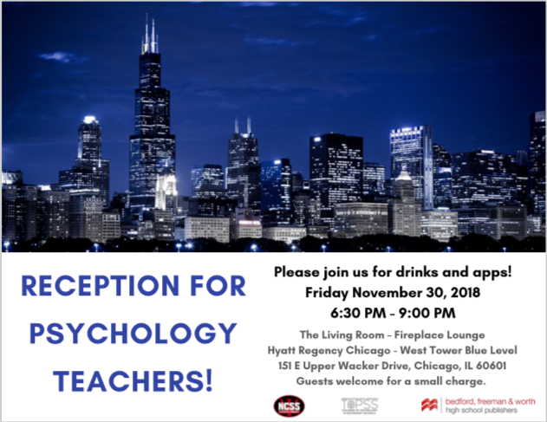

Slide 2
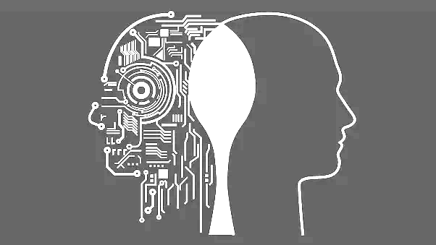
TEACHING STRESS MANAGEMENT WITHOUT SACRIFICING RIGOR

Slide 3
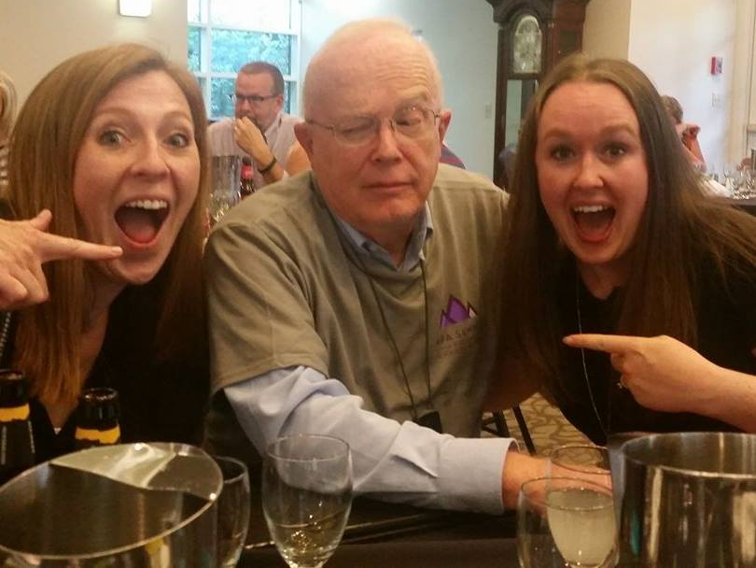
Heather Chambers
Glenbrook South HS
hchambers@glenbrook225.org
insta: @socialstudiessquared
twitter: @irishteach
Melissa Rogers
Cedar Falls HS
melissa.rogers@cfschools.org
Twitter: @cfhspsych
https://tinyurl.com/2018ncss

Slide 4
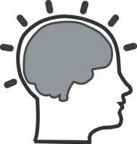
WHO?
WHAT?
HOW?
On-level and AP Psychology students
Students experiencing stress Teens & Stress, APA
Stress management techniques
Rigor through review
Psych Lab!
Activities taken from: https://www.huffpost.com/entry/reduce-stress-research_n_2884876

Slide 5
MATERIALS
Teacher Provides | Student Brings
Access to instructions/options Lab sheets (pgs 2-3 of above link) Coloring pages* Coloring utensils* Gratitude Journal sheets Yoga mat* Blood pressure cuffs *Student could provide as well | Cell phone Laptop Earbuds Writing utensil Book to read Work

Slide 6
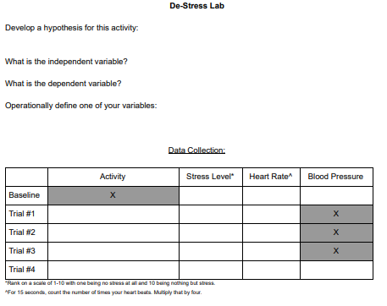
LAB SHEET
Review Research Methods unit: -Hypothesis -IV -DV -Operational definition -(Confounding variables) -(Correlation)
Collect data- stress level, pulse and/or blood pressure

Slide 7
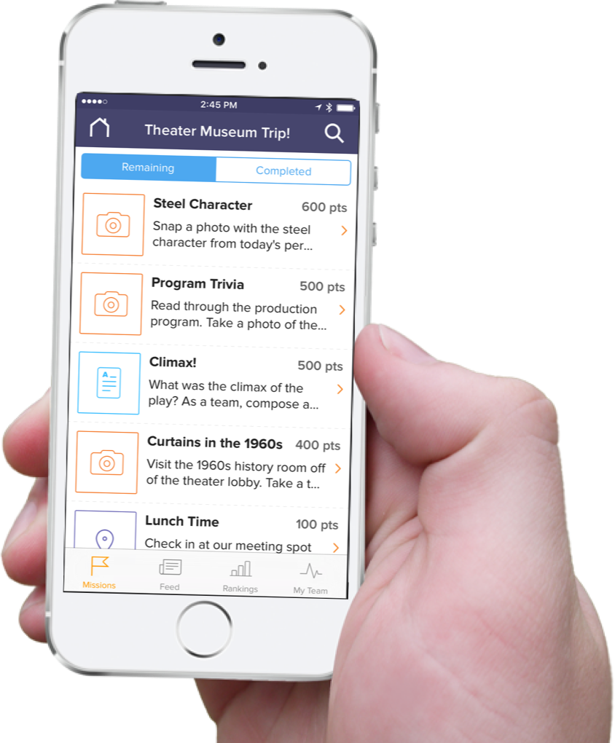
GO FOR A WALK CODE: N85VQM
Goosechase
INCLUDES: Art therapy* Massage Chewing gum Meditation Deep breathing Music Hugs Nap Journaling Religion Kissing Tea Laughing Yoga
Activities (with individual links to research included)
Research on exercise

Slide 8
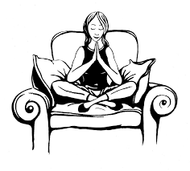
MEDITATION & MINDFULNESS
Guided meditation video on YouTube
Apps: Headspace
Pacifica
Calm
Research on meditation Research on mindfulness

Slide 9
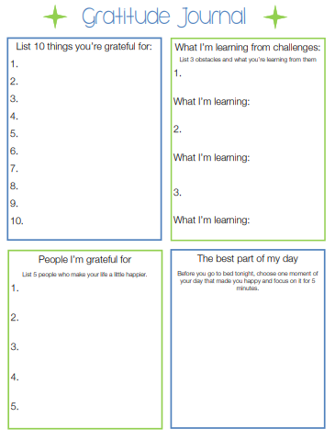
JOURNAL YOUR THOUGHTS
Gratitude -Things, lessons being learned, people, reflect
SoulPancake video -Write about specific person, then communicate the gratitude
Gratitude journal prompts (scroll down)
Research on journaling Research on gratitude

Slide 10
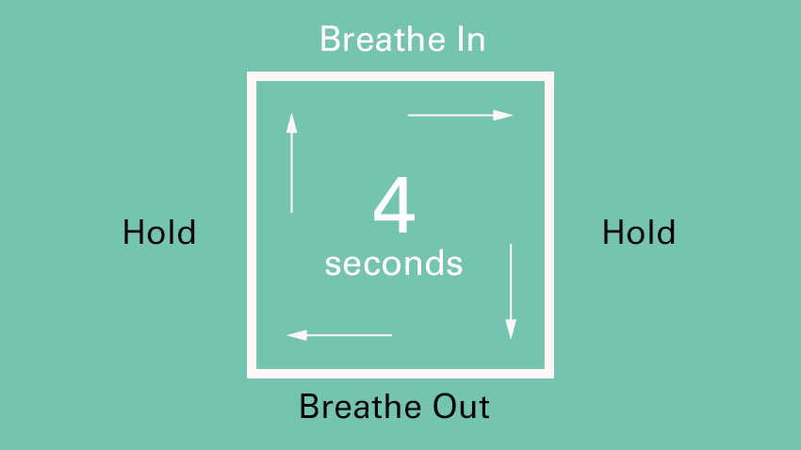
TAKE A BREATH
Controlled, slow breathing
Rainy Mood A Soft Murmur Soundrown
Research on breathing and cortisol Research on breathing and blood pressure

Slide 11
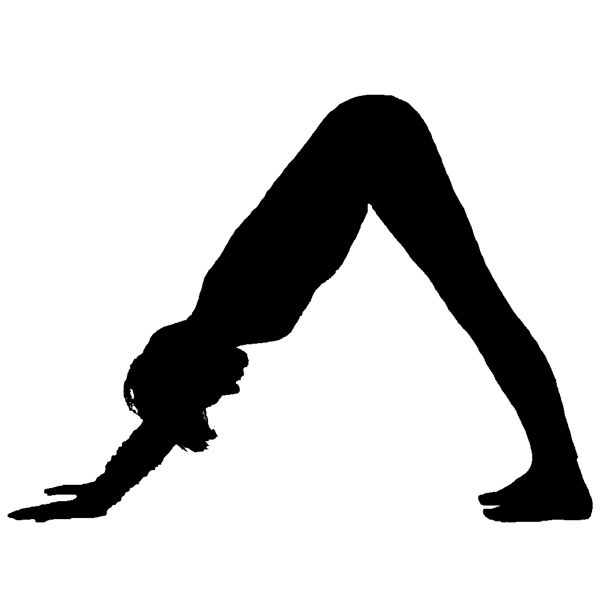
YOGA
YouTube
Research on yoga breathing Research on exercise

Slide 12
ARTS & CRAFTS
Coloring pages
Neon Flames
Research on art and cortisol

Slide 13
READ A BOOK
Student choice
Psychology books!
The Man Who Mistook his Wife for a Hat Turtles All the Way Down Man’s Search for Meaning Brain on Fire
Research on reading

Slide 14
REDUCE YOUR WORKLOAD
Homework
Paper
Project
Scholarship application
Application to optimal arousal
Research on planning & self-efficacy Research on perceptual load

Slide 15
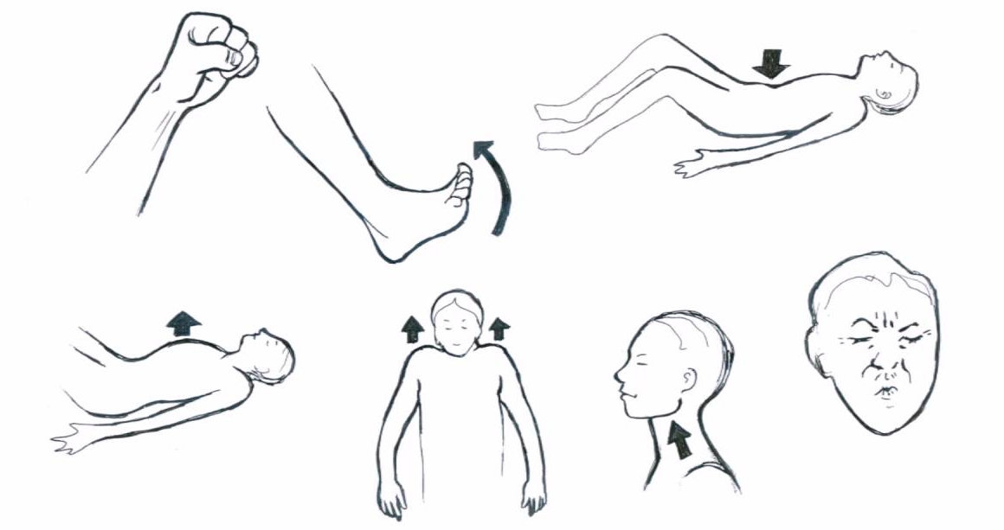
PROGRESSIVE RELAXATION
YouTube
Research on progressive relaxation
Notes:
Not recommended for those with PTSD- can trigger a reaction

Slide 16
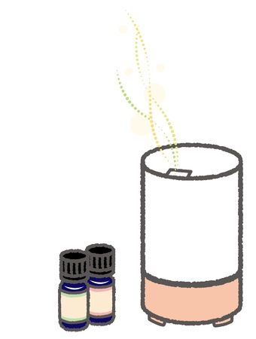
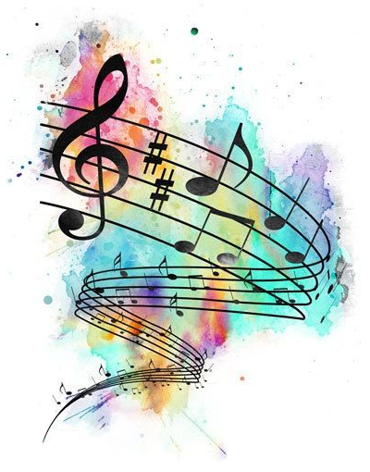
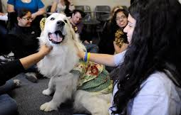
OTHER POSSIBLE OPTIONS
Music -The most relaxing song ever?
Aromatherapy -Lavender
Pets

Slide 17
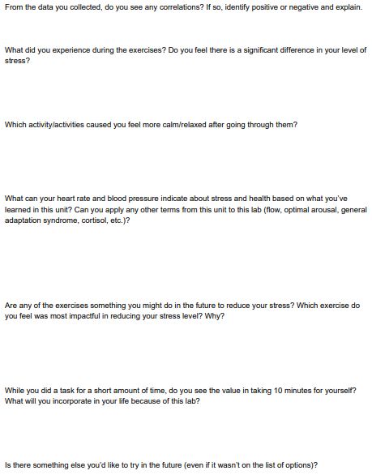
REFLECTION
Evaluation of data collection -Confounding variables -Correlation
Application to Motivation & Emotion -Short- vs. long-term effects
Appraisal of experience
Incorporation into daily life

