Slide 1
Depression II
Recent Research in Treating Depression (2015 )
See Therapy Without the Coin Toss, NYT January 13, 2015

Slide 2
Helen Mayberg’s study in JAMA Psychiatry 2014
Identified a potential biomarker in the brain
Biomarker predicts whether a depressed patient will respond better to psychotherapy or antidepressant medication
Used PET scans and found striking brain differences between patients that did well with selective serotonin reuptake inhibitor (SSRI) versus cognitive behavioral therapy (CBT)

Slide 3
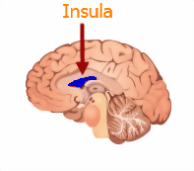
Mayberg (2)
Patients who had low activity in the anterior insula before treatment responded quite well to CBT but poorly to the SSRI.
Patients who had high activity in the anterior insula before treatment responded quite well to the SSRI but poorly to the CBT.

Slide 4
Why insula?
The insula is centrally involved in the capacity for emotional self-awareness, cognitive control, and decision making.
All the above are impaired by depression.
Perhaps CBT teaches patients to control their emotionally-disturbing thoughts in a way an antidepressant cannot.

Slide 5
Antidepressants versus psychotherapy
Antidepressants and psychotherapy share some common effects, but also have different effects in distinct brain regions.
One day soon, we may be able to quickly scan a patient with an MRI or pet, check the brain activity “fingerprint,” and select an antidepressant or psychotherapy accordingly.

Slide 6
Childhood Trauma
Evidence shows that depressed patients that have a history of childhood trauma, such as the early loss of a parent or sexual or physical abuse, respond better to psychotherapy than an antidepressant.

Slide 7
Childhood Trauma (2)
Why? A history of trauma early in life is strongly correlated with shrinkage of the hippocampus, a brain region critical to memory and learning.
Perhaps the active learning of psychotherapy helps a compromised hippocampus. Antidepressants alone are not enough.

Slide 8
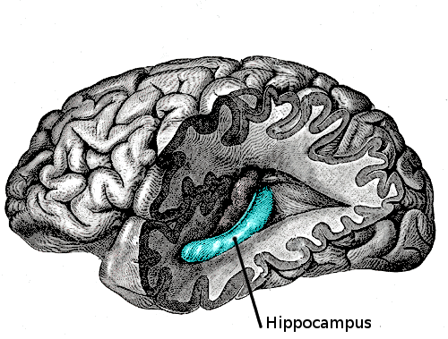
Childhood Trauma (3)
Considering the high rate of early trauma in chronically depressed patients (33% parental loss, 45% physical abuse –Nemeroff) psychotherapy should be considered.

Slide 9
How does psychotherapy work?
We still don’t know whether the nonspecific nature of talk therapy—feeling understood and cared for by another human being—is responsible for its effect.
Or will specific types of therapy, like CBT, show distinctly different clinical and neurobiological effects?

