Slide 1
FEDERALISM
Chapter 3
O’Connor and Sabato
American Government:
Continuity and Change

Slide 2
Federalism
In this chapter we will cover…
The Roots of the Federal System
Federalism and the Marshall Court
Dual Federalism—Taney Court, Slavery, Civil War
Cooperative Federalism: New Deal and Growth of Government
New Federalism: Power to the States

Slide 3
The Roots of the Federal System
The Framers worked to create a political system that was halfway between the failed confederation of the Articles of Confederation and the tyrannical unitary system of Great Britain.
The three major arguments for federalism are:
the prevention of tyranny;
the provision for increased participation in politics;
and the use of the states as testing grounds or laboratories for new policies and programs.

Slide 4
Federalism Defined
Federalism is a political system in which power is divided and shared between the national/central government and the states (regional units) in order to limit the power of government.

Slide 7
Powers Under the Constitution
National powers under the Constitution:
supremacy clause
necessary and proper clause
enumerated powers
and implied powers.

Slide 8
State Powers Under the Constitution
Articles I, II and IV
10th Amendment (reserve or police powers)

Slide 9
Concurrent and Denied Powers
The national and state systems overlap—concurrent powers.
Some powers are explicitly denied to the national government or the states under Article I of the Constitution
Arbitrary actions affecting constitutional rights and liberties
Bill of attainder and ex post facto laws

Slide 10
Relations within the states: local government
Local government authority is granted through state governments, which establish or charter administration subdivisions to execute the local duties.

Slide 11
Article I, Section 8
The enumerated powers of the central government consist of the power to:
lay and collect taxes, duties, and imposts
provide for the common defense and general welfare of the United States
regulate commerce with foreign nations, and among the states, and with Indian tribes
coin money and regulate the value thereof
declare war

Slide 12
Implied Powers
The central government may make all laws which shall be necessary and proper for carrying into execution the enumerated powers.
The necessary and proper clause has often been used to expand the powers of the national government.

Slide 13
State Powers
Most of State powers come from the Tenth Amendment that says: "The powers not delegated to the United States by the Constitution, nor prohibited by it to the States, are reserved to the States respectively, or to the people."
These are often referred to as reserve or police powers. States also have some powers that the central government also wields called concurrent powers such as the right to tax, borrow money, establish courts, and make and enforce laws.

Slide 14
Denied Powers
Article I, section 9 lays out powers denied to the central government.
For example: give preference to ports of one state over another
Article I, section 10 lays out the powers denied to the states.
For example: enter into treaties, alliances, or confederations

Slide 16
Relations among the States
The Framers wanted a single country, not thirteen squabbling semi-countries.
Article IV requires states to give “full faith and credit” to each others’ laws.
States are also required to extradite criminals if asked by another state.

Slide 17
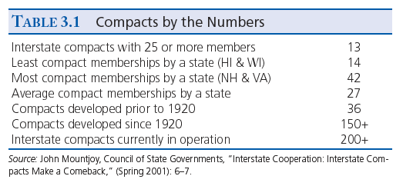

Slide 18
Federalism and the Marshall Court
The allocation of powers in our federal system has changed dramatically over the years.
The Supreme Court in its role as interpreter of constitution has been a major player in the redefinition of our Federal system.
McCulloch v. Maryland (1819)
Gibbons v. Ogden (1824)
Dred Scott v. Sandford (1857)

Slide 19
McCulloch v. Maryland (1819)
McCulloch was the first major decision by the Supreme Court under Chief Justice John Marshall about the relationship between the states and the national government.
The Court upheld the power of the national government and denied the right of a state to tax a federal bank.
The Court’s broad interpretation of the necessary and proper clause paved the way for later rulings upholding expansive federal powers.

Slide 20
Gibbons v. Ogden (1824)
The Gibbons case centered on the conflict between the states and the powers of Congress. The Court ruled in favor of a broad interpretation of federal power
Could New York grant a monopoly concession on the navigation of the Hudson River? The Hudson River forms part of the border between New York and New Jersey and the U.S. Congress also licensed a ship to sail the Hudson.
The main constitutional question in Gibbons was about the scope of Congress' authority under the Commerce Clause.
In Gibbons, the Court upheld broad congressional power over interstate commerce.

Slide 21
Dual Federalism: The Taney Court, Slavery and the Civil War
Marshall’s successor, Roger Taney, Chief Justice of the Supreme Court, articulated the notions of concurrent power and dual federalism.
Dual federalism posits having separated and equally powerful state and national governments is the best arrangement.

Slide 22
Dred Scott v. Sandford (1857)
The Supreme Court articulated the idea of concurrent powers and dual federalism in which separate but equally powerful levels of government is preferable, and the national government should not exceed its enumerated powers.
The Taney Court held that Mr. Scott, a slave moved to the North, was not a U.S. citizen and therefore not entitled to sue in federal court.
The case was dismissed and Scott remained a slave.
Taney further wrote that Congress had no power to abolish slavery in the territories and slaves were private property protected by the Constitution.
The case outraged Northern sentiments

Slide 23
The Civil War and Beyond
Dual federalism remained the Supreme Court's framework for federalism even after the adoption of the Thirteenth, Fourteenth, and Fifteenth amendments.
Dual federalism finally ended in the 1930s, when the crisis of the Great Depression demanded powerful actions from the national government.

Slide 24
Cooperative Federalism
Prior to the 1930s, many scholars used the analogy of a layer cake to describe federalism.
Each layer had clearly defined powers and responsibilities.
After the New Deal, the analogy of a marble cake seemed more appropriate because the lines of authority were much more mixed.
This marble cake federalism is often called cooperative federalism and has a much more powerful national government.
States have a cooperative role, as did many cities.

Slide 25
The New Deal
FDR enacted a new, higher level of government intervention intended to stabilize the economy and reduce suffering.
The national government exercised tremendous authority
Forced all levels of government, including local govt., to work cooperatively.

Slide 26
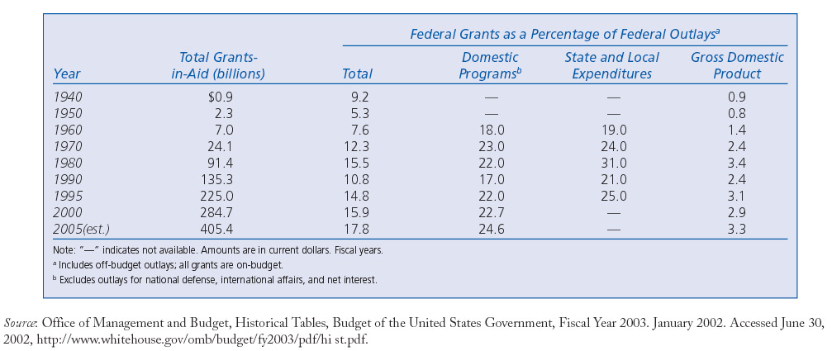
Federal Grant-in-Aid Outlays, 1940-2005

Slide 27
Creative Federalism
Creative Federalism was popular during the Johnson administration from 1963 to 1969. It emphasized that the federal government determined the needs of the states.
Federal grants: allocation of federal money to the states for a specific purpose.
Federal leadership saw these grants as a way to compel individual states to behave in ways desired by the national government. If the states refused to cooperate with the federal government, the Feds would withhold funds.

Slide 28
New Federalism: The Reagan Revolution
Shortly after taking office in 1980, former California Governor Ronald Reagan set to work enacting his vision of the “New Federalism” by drastically cutting federal domestic programs and income taxes in an attempt to reestablish the primacy of the states. For the first time in thirty years, federal aid to state and local governments declined.

Slide 29
The Devolution Revolution
Under Clinton, the Republican Congress prevented Congress from passing unfunded mandates without debate and returned the administration of welfare programs to the states
Preemption: allows the national government to override state or local actions in certain areas.
Unfunded mandates: laws that require states to comply with federal regulations or face civil and/or criminal penalties. The laws contain little or no federal funding.

Slide 30
Federalism under GW Bush
NCLB preemption of state laws
Republicans supported preemption as well as Democrats

Slide 31
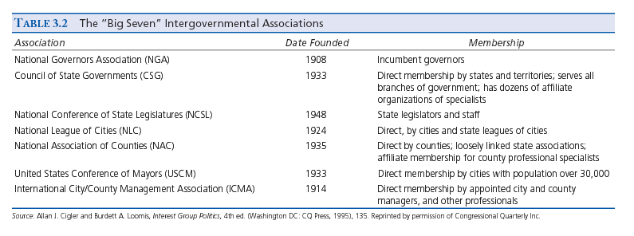

Slide 32
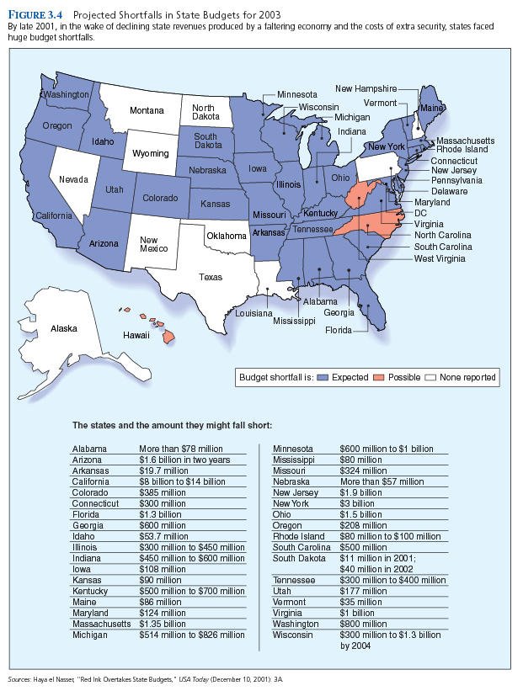

Slide 33
Federalism and the Supreme Court
By the 1980s and 1990s, many Americans began to think that the national government was too big, too strong, and too distant to understand their concerns.
The Supreme Court, once again, played a role in this new evolution of federalism.
For example: Since 1989, the Court has been allowing states to introduce limitations on the right to an abortion.

Slide 34
Federalism and the Supreme Court
Devolution revolution not as clear cut
Rehnquist court supported states rights
Roberts court not so much (Obamacare)

Slide 35
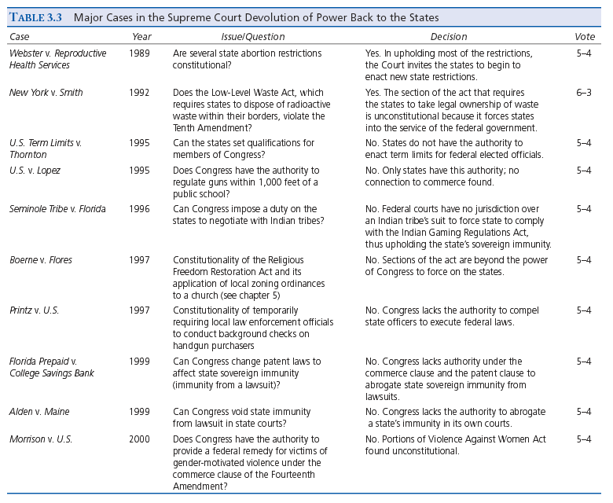

Slide 36
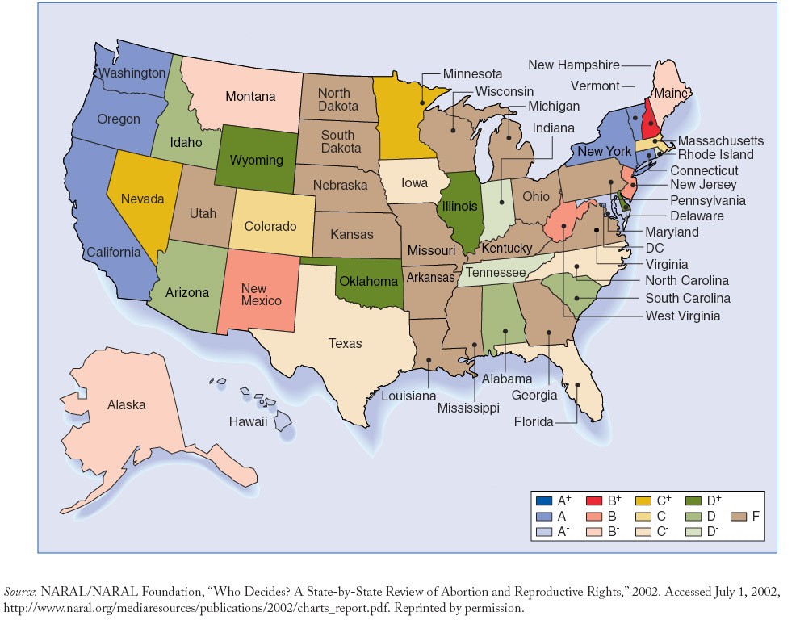
State-by-State Report Card on Access to Abortion

