Slide 1
Typical Axis I Disorders Source: Wade and Tavris
Spinrad/Psychology

Slide 2
Anxiety Disorders
Generalized anxiety disorder: continuous, uncontrollable anxiety, feeling of foreboding and dread
Posttraumatic stress disorder(PTSD): reliving the trauma
Panic disorder: recurring attacks of intense fear or panic with feeling s of impending doom or death

Slide 3
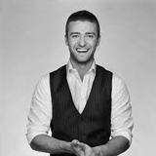
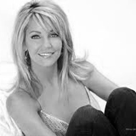
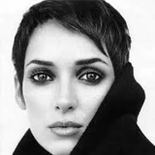
Celebrities with anxiety disorders

Slide 4
Anxiety disorders (cont)
Phobias: an exaggerated fear of a specific situation, activity, or thing
Agoraphobia: being away from a safe place, usually home
Arachnophobia: fear of spiders
Claustrophobia: fear of being in enclosed spaces

Slide 5
Anxiety disorders (cont)
Obsessive-compulsive disorder (OCD): recurrent, persistent, unwished-for thoughts or images (obsessions) and repetitive, ritualized, stereotyped behaviors that the person feels compelled to carry out (compulsions)
May involve an organic (biological) cause involving the brain’s “alarm” system

Slide 6
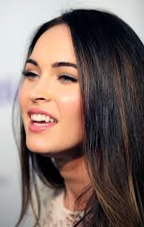
Megan Fox

Slide 7
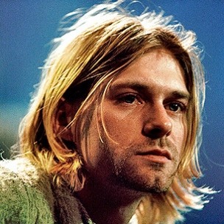
Mood Disorders
Range from extreme depression to extreme mania

Slide 8
Mood Disorders (cont)
Major Depression
Widespread
Involves emotional, behavioral, cognitive, and physical changes that disrupt ordinary functioning for six months or longer
Despairing, hopeless
Suicidal ideation
Unable to do normal things
Exaggerate failings
Sleep, eating, and concentration problems

Slide 9
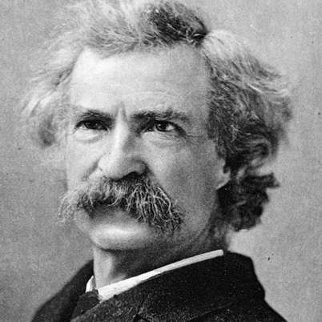
Mood Disorders (cont)
Mania: an abnormally high state of exhilaration
Opposite symptoms from depression
Occasionally psychotic symptoms
Bipolar disorder: alternating between periods of depression and periods of mania

Slide 10
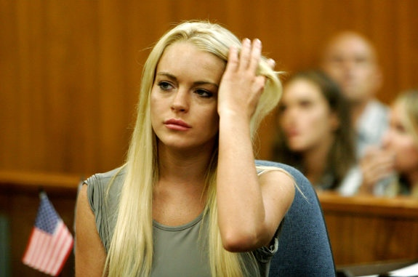
Drug Abuse and Addiction
Biological versus Learning Models
Alcohol most prevalent
Other types include gambling

Slide 11
Schizophrenia
Active/positive symptoms involve a distortion of thinking and behavior
Bizarre delusions
Hallucinations
Disorganized, incoherent speech
Grossly inappropriate and disorganized behavior

Slide 12
Schizophrenia (cont)
Negative symptoms involve the loss of normal traits or abilities such as the ability to speak fluently and feel warm emotions
Loss of motivation
Emotional flatness
Impoverished speech
Social withdrawal

Slide 13
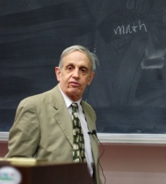
Celebrities with schizophrenia

