Slide 1
Personality Disorders (Axis II)
Spinrad/Psychology

Slide 2
Definition
A personality disorder is a type of mental illness in which you have trouble perceiving and relating to situations and to people — including yourself. (Source, Mayo Clinic)

Slide 3
Definition (continued)
In general, having a personality disorder means you have a rigid and unhealthy pattern of thinking and behaving no matter what the situation. This leads to significant problems and limitations in relationships, social encounters, work and school.

Slide 4
Symptoms
Frequent mood swings
Stormy relationships
Social isolation
Angry outbursts
Suspicion and mistrust of others
Difficulty making friends
A need for instant gratification
Poor impulse control
Alcohol or substance abuse
(Mayo Clinic)

Slide 5
Cluster A : Odd or eccentric thinking or behavior
Paranoid personality disorder
Distrust and suspicion of others
Believing that others are trying to harm you
Emotional detachment
Hostility

Slide 6
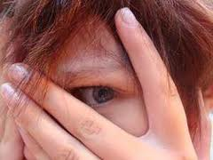
Paranoid Personality Disorder

Slide 7
Schizoid Personality Disorder
Lack of interest in social relationships
Limited range of emotional expression
Inability to pick up normal social cues
Appearing dull or indifferent to others

Slide 8
Schizoid Personality Disorder

Slide 9
Schizotypal Personality Disorder
Peculiar dress, thinking, beliefs or behavior
Perceptual alterations, such as those affecting touch
Discomfort in close relationships
Flat emotions or inappropriate emotional responses
Indifference to others
"Magical thinking" — believing you can influence people and events with your thoughts
Believing that messages are hidden for you in public speeches or displays

Slide 10
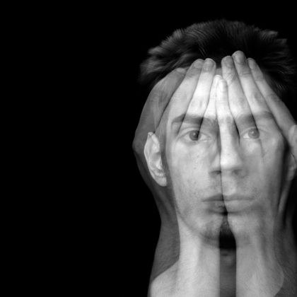
Schizotypal Personality Disorder

Slide 11
Cluster B: dramatic, overly emotional thinking or behavior
Antisocial (formerly called sociopathic) personality disorder
Disregard for others
Persistent lying or stealing
Recurring difficulties with the law
Repeatedly violating the rights of others
Aggressive, often violent behavior
Disregard for the safety of self or others

Slide 12
Antisocial Personality Disorder

Slide 13
Borderline personality disorder
Impulsive and risky behavior
Volatile relationships
Unstable mood
Suicidal behavior
Fear of being alone

Slide 14
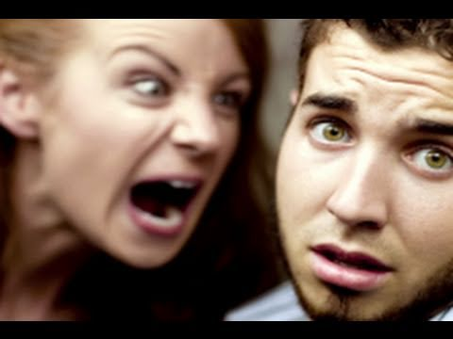
Borderline personality disorder

Slide 15
Histrionic personality disorder
Constantly seeking attention
Excessively emotional
Extreme sensitivity to others' approval
Unstable mood
Excessive concern with physical appearance

Slide 16
Histrionic personality disorder

Slide 17
Narcissistic personality disorder
Believing that you're better than others
Fantasizing about power, success and attractiveness
Exaggerating your achievements or talents
Expecting constant praise and admiration
Failing to recognize other people's emotions and feelings

Slide 18
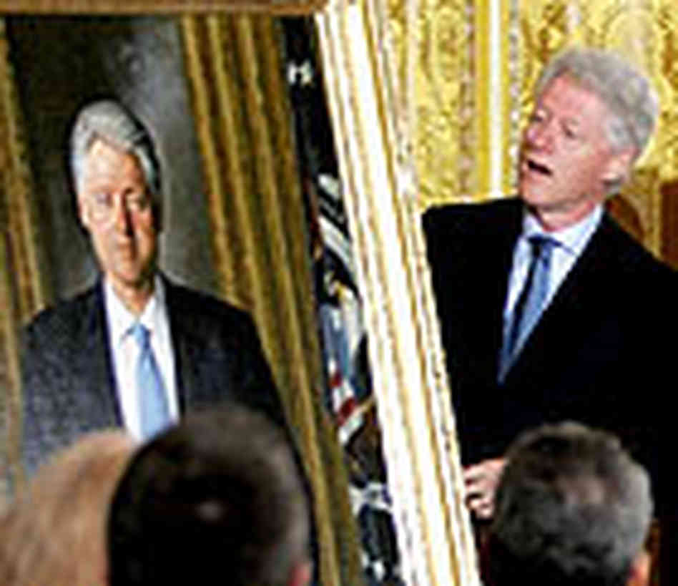
Narcissistic personality disorder

Slide 19
Cluster C: anxious, fearful thinking or behavior
Avoidant personality disorder
Hypersensitivity to criticism or rejection
Feeling inadequate
Social isolation
Extreme shyness in social situations
Timidity

Slide 20
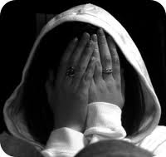
Avoidant personality disorder

Slide 21
Dependent personality disorder
Excessive dependence on others
Submissiveness toward others
A desire to be taken care of
Tolerance of poor or abusive treatment
Urgent need to start a new relationship when one has ended

Slide 22
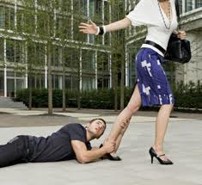
Dependent personality disorder

Slide 23
Obsessive-compulsive personality disorder
Preoccupation with orderliness and rules
Extreme perfectionism
Desire to be in control of situations
Inability to discard broken or worthless objects
Inflexibility
Obsessive-compulsive personality disorder isn't the same as obsessive-compulsive disorder, a type of anxiety disorder.

Slide 24
Obsessive-compulsive personality disorder

