Slide 1
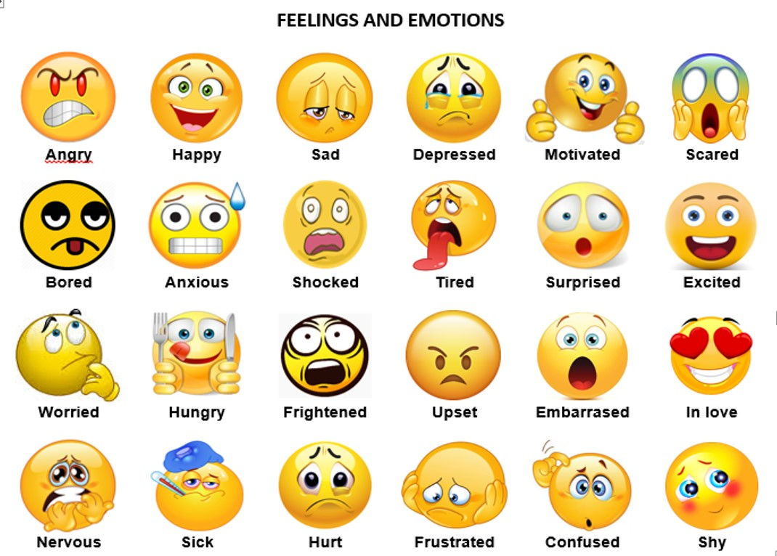
January 14, 2019
Modules 41 & 42

Slide 2
Emotion
Emotions = a mix of bodily arousal, expressive behaviors and conscious experience
Theories of Emotion
James-Lange Theory = awareness of our physiological (bodily) responses to an emotion-arousing stimulus
Stimulus → Arousal → Emotion
Snake → Heart Pounding → Fear

Slide 3
Emotion
Theories of Emotion
Cannon-Bard Theory = emotion-arousing stimulus simultaneously triggers a physiological response and the experience of emotion (simultaneous activation of SNS and brain’s cortex)
Stimulus → Arousal & Emotion
Snake → Heart Pounding and Fear

Slide 4
Emotion
Theories of Emotion
Two-Factor Theory (Schachter-Singer) = emotions have two ingredients -- physical arousal and cognitive label of the arousal
Stimulus → Arousal & Cognitive Label → Emotion
Snake → Heart Pounding & “I must be afraid” → Fear
Arousal can spillover from one event to the next (Spillover Effect)

Slide 5
Theory | Explanation of Emotions | Example
James- Lange | Emotions arise from our awareness of our bodily responses to emotion arousing stimuli: stimuli →arousal → emotion. | We observe our heart racing after a threat and then feel afraid.
Cannon-Bard | Emotion-arousing stimuli trigger our bodily responses and simultaneous subjective experience. | Our heart races at the same time that we feel afraid.
Schachter- Singer | Our experience of emotion depends on two factors: general arousal and a conscious cognitive label. | We may interpret our arousal as fear or excitement, depending on the context.
Zajonc; LeDoux | Some embodied responses happen instantly, without conscious appraisal. | We automatically feel startled by a sound in the forest before labeling it as a threat.
Lazarus | Cognitive appraisal (“Is it dangerous or not?”)—sometimes without our awareness—defines emotion. | The sound is “just the wind.”

Slide 6
Physiology of Emotions
Autonomic Nervous System
Sympathetic Nervous System (SNS) directs adrenal glands to release epinephrine (adrenaline) and norepinephrine (noradrenaline)
Parasympathetic Nervous System (PNS) gradually calms our body
Watching fearful faces = amygdala activity
Depressed people = more activity in the right frontal lobe
Positive moods = more left frontal lobe activity

Slide 7
Facial Feedback Effect = facial muscle states can trigger corresponding feelings
1. Smile a BIG smile right now -- hold it for ten seconds.
2. Frown a BIG frown right now -- hold it for ten seconds.

Slide 8
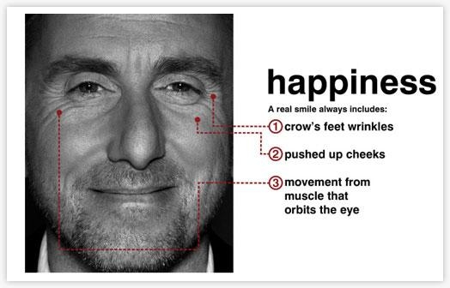
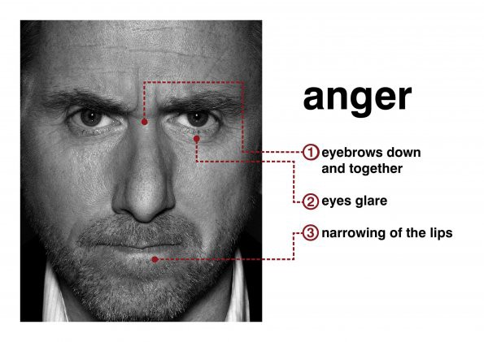
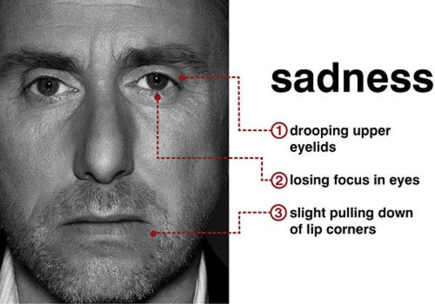
https://www.youtube.com/watch?v=bWyhsqh_e9s (4 min)
https://www.youtube.com/watch?v=gHvqDzh4grc (2 min)

