Slide 1
The Political Landscape
Chapter 1
O’Connor and Sabato
American Government:
Continuity and Change

Slide 2
The Political Landscape
In this chapter we will cover…
The Roots of American Government: Where Did the Ideas Come From?
Characteristics of American Democracy
The Changing Political Culture and Characteristics of the American People
Political Culture and Views of Government

Slide 3
Functions of Government
Framers believed function was creating mechanisms to allow individuals to solve conflicts in an orderly and peaceful manner. How much authority must be given to government?
Establishing justice
Ensuring domestic tranquility
Providing for common defense
Promoting general welfare
Securing the blessings of liberty

Slide 4
Types of government (Aristotle)
Monarchy (public interest)
Tyranny (totalitarianism) (self interest)
Aristocracy (public interest)
Oligarchy (self interest)
Polity (public interest)
Democracy (self interest)

Slide 5
The Roots of American Government: Where Did the Ideas Come From?
Aristotle and the Greeks articulated the idea of natural law.
Society should be governed by ethical principles that are part of nature and can be understood through reason.
Government before had been by “divine right,” but these philosophical changes put humans on the road toward self government.

Slide 6
Hobbes and Locke and Popular Consent
Social Contract Theory
All individuals are free and equal by natural (G-d-given) right.
People are source of power
People give consent to government to rule
Government provides protection of natural rights
Hobbes’ Leviathan v. Locke’s preservation of private property

Slide 7
Devising a National Government
The American colonists rejected the British idea of a strong ruler and aristocratic system
The colonists found direct democracy to be unworkable so replaced town meetings with indirect democracy, a republic.

Slide 8
2. Characteristics of American Democracy
popular consent
popular sovereignty
majority rule
individualism
equality
personal liberty
civil society
Religious faith

Slide 9
The Changing Political Culture and Characteristics of the American People
Population of the United States:
July 1, 1900 there were 76,094,000
Today there are over 317,413,000
One birth every.................................. 8 seconds
One death every.................................. 13 seconds
One international migrant (net) every............ 36 seconds
One Federal U.S. citizen (net) returning every...2891 seconds
Net gain of one person every..................... 13 seconds
Source: U.S. Census Bureau, Population Division

Slide 10
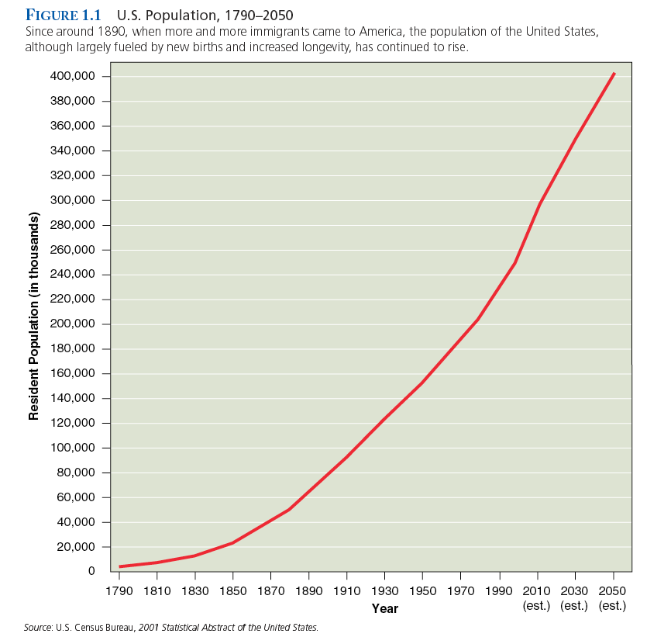

Slide 11
Changing Demographics
Not only are we bigger we are also more diverse.
In colonial times most (non-indigenous) Americans were Anglo-Saxon.
In 2010, the U.S. population was made up of…
whites 63.7%
African Americans 12.6%
Hispanics 16.4%
Asian 4.8%

Slide 12
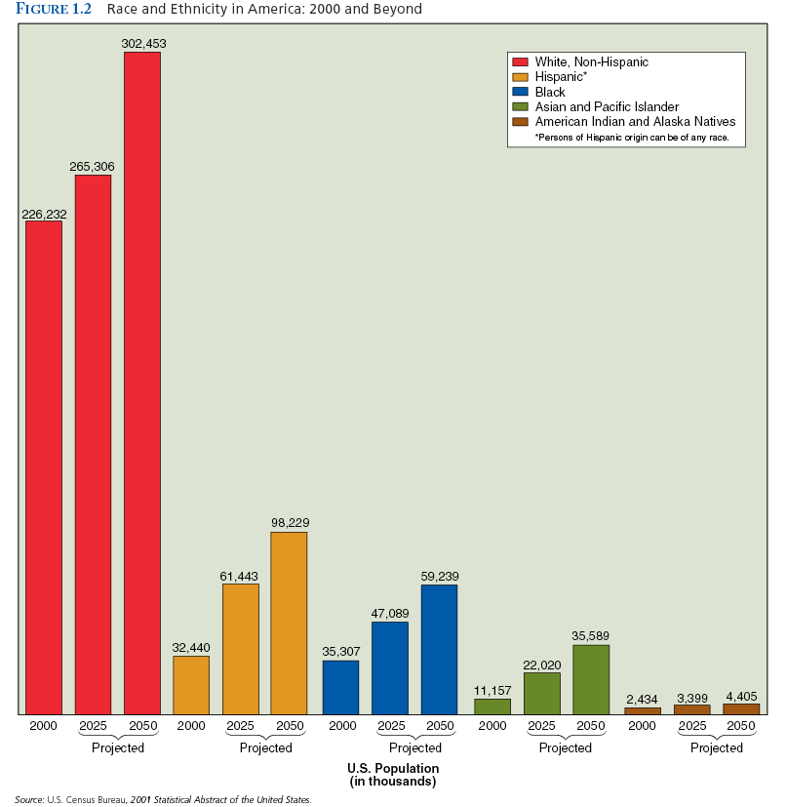

Slide 13
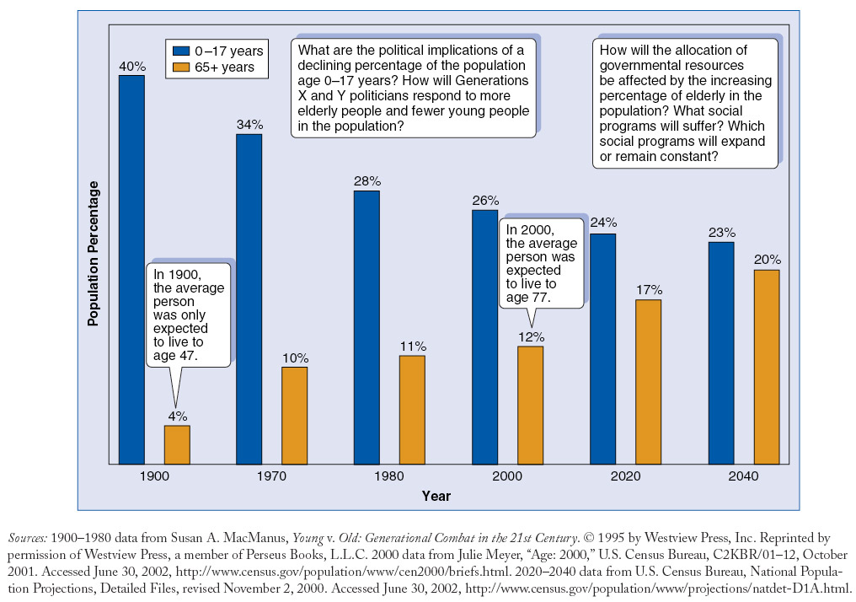
Changing Age Composition in the United States

Slide 14
Changes in family and family size
Majority think two children is the best
More divorce and single-parent households
More demands placed for government programs such as after-school programs

Slide 15
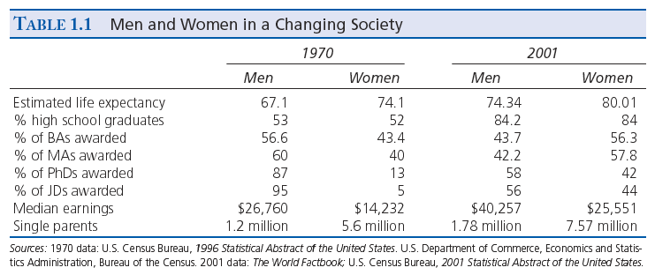

Slide 16
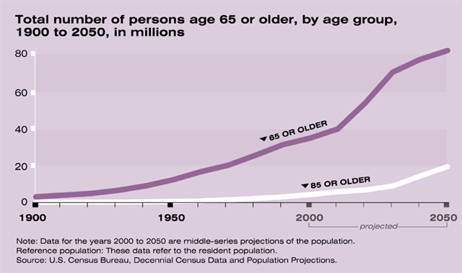
Graying of America
In 2011, the “baby boom” generation will begin to turn 65, and by 2030, it is projected that one in five people will be age 65 or older.
The growth of the population age 65 and older will affect every aspect of our society, presenting challenges as well as opportunities to policymakers, families, businesses, and health care providers.

Slide 17
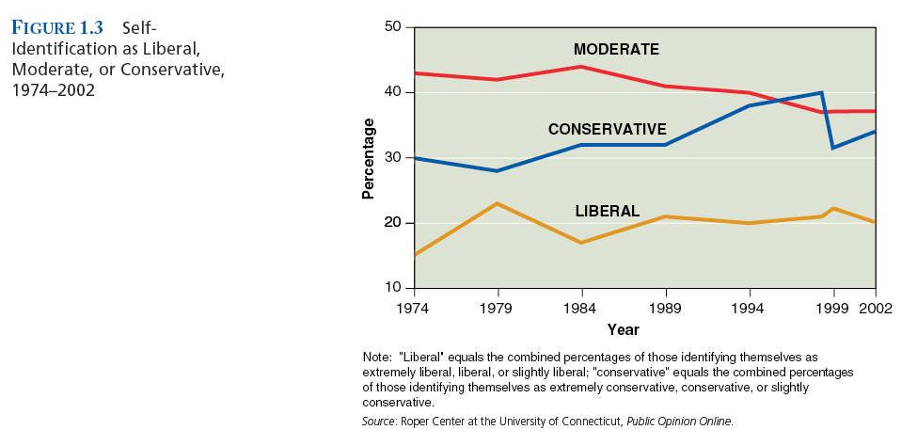
Ideology of Americans

Slide 18
Ideologies perform four key functions
1. Explanation
2. Evaluation
3. Orientation
4. Political program

Slide 19
Ideology of Americans
Conservativism – thought to believe that a government is best that governs least and that big government can only infringe on individual, personal, and economic rights.

Slide 20
Ideology of Americans
Liberalism – thought to favor government involvement in the economy and the provision of social services and to take an activist role in protecting women, the elderly, minorities, and the environment.

Slide 21
Ideology of Americans
Libertarianism – thought to favor a free market economy and no governmental interference in personal liberties.

Slide 23
Political Culture and Views of Government
High Expectations
A Missing Appreciation of the Good
Mistrust of Politicians
Voter Apathy
Redefining Our Expectations

Slide 24
High Expectations and No Appreciation of the Good
Americans expect more and more from their government.
Many Americans do not know what government actually does for them.
Regulation of airwaves for television and radio
Clean water
FDA inspections
Air traffic control

Slide 25
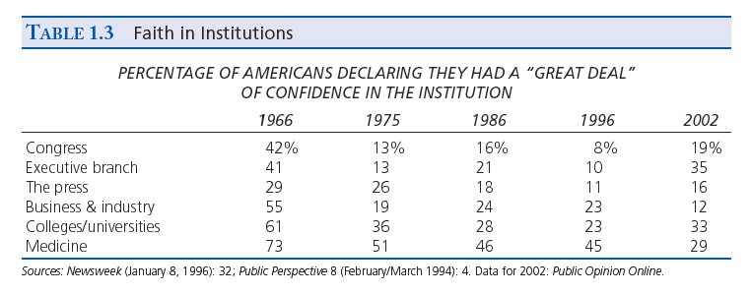

Slide 26
